Slide 1
The art of Seeing
Does looking at art help to avoid cognitive bias in decision making?
Laura Zwaan, Alex Linsen, Gijs Elshout, David Pols, Marijn Hulsbergen, Walter van den Broek, Silvia Mamede.

Slide 2
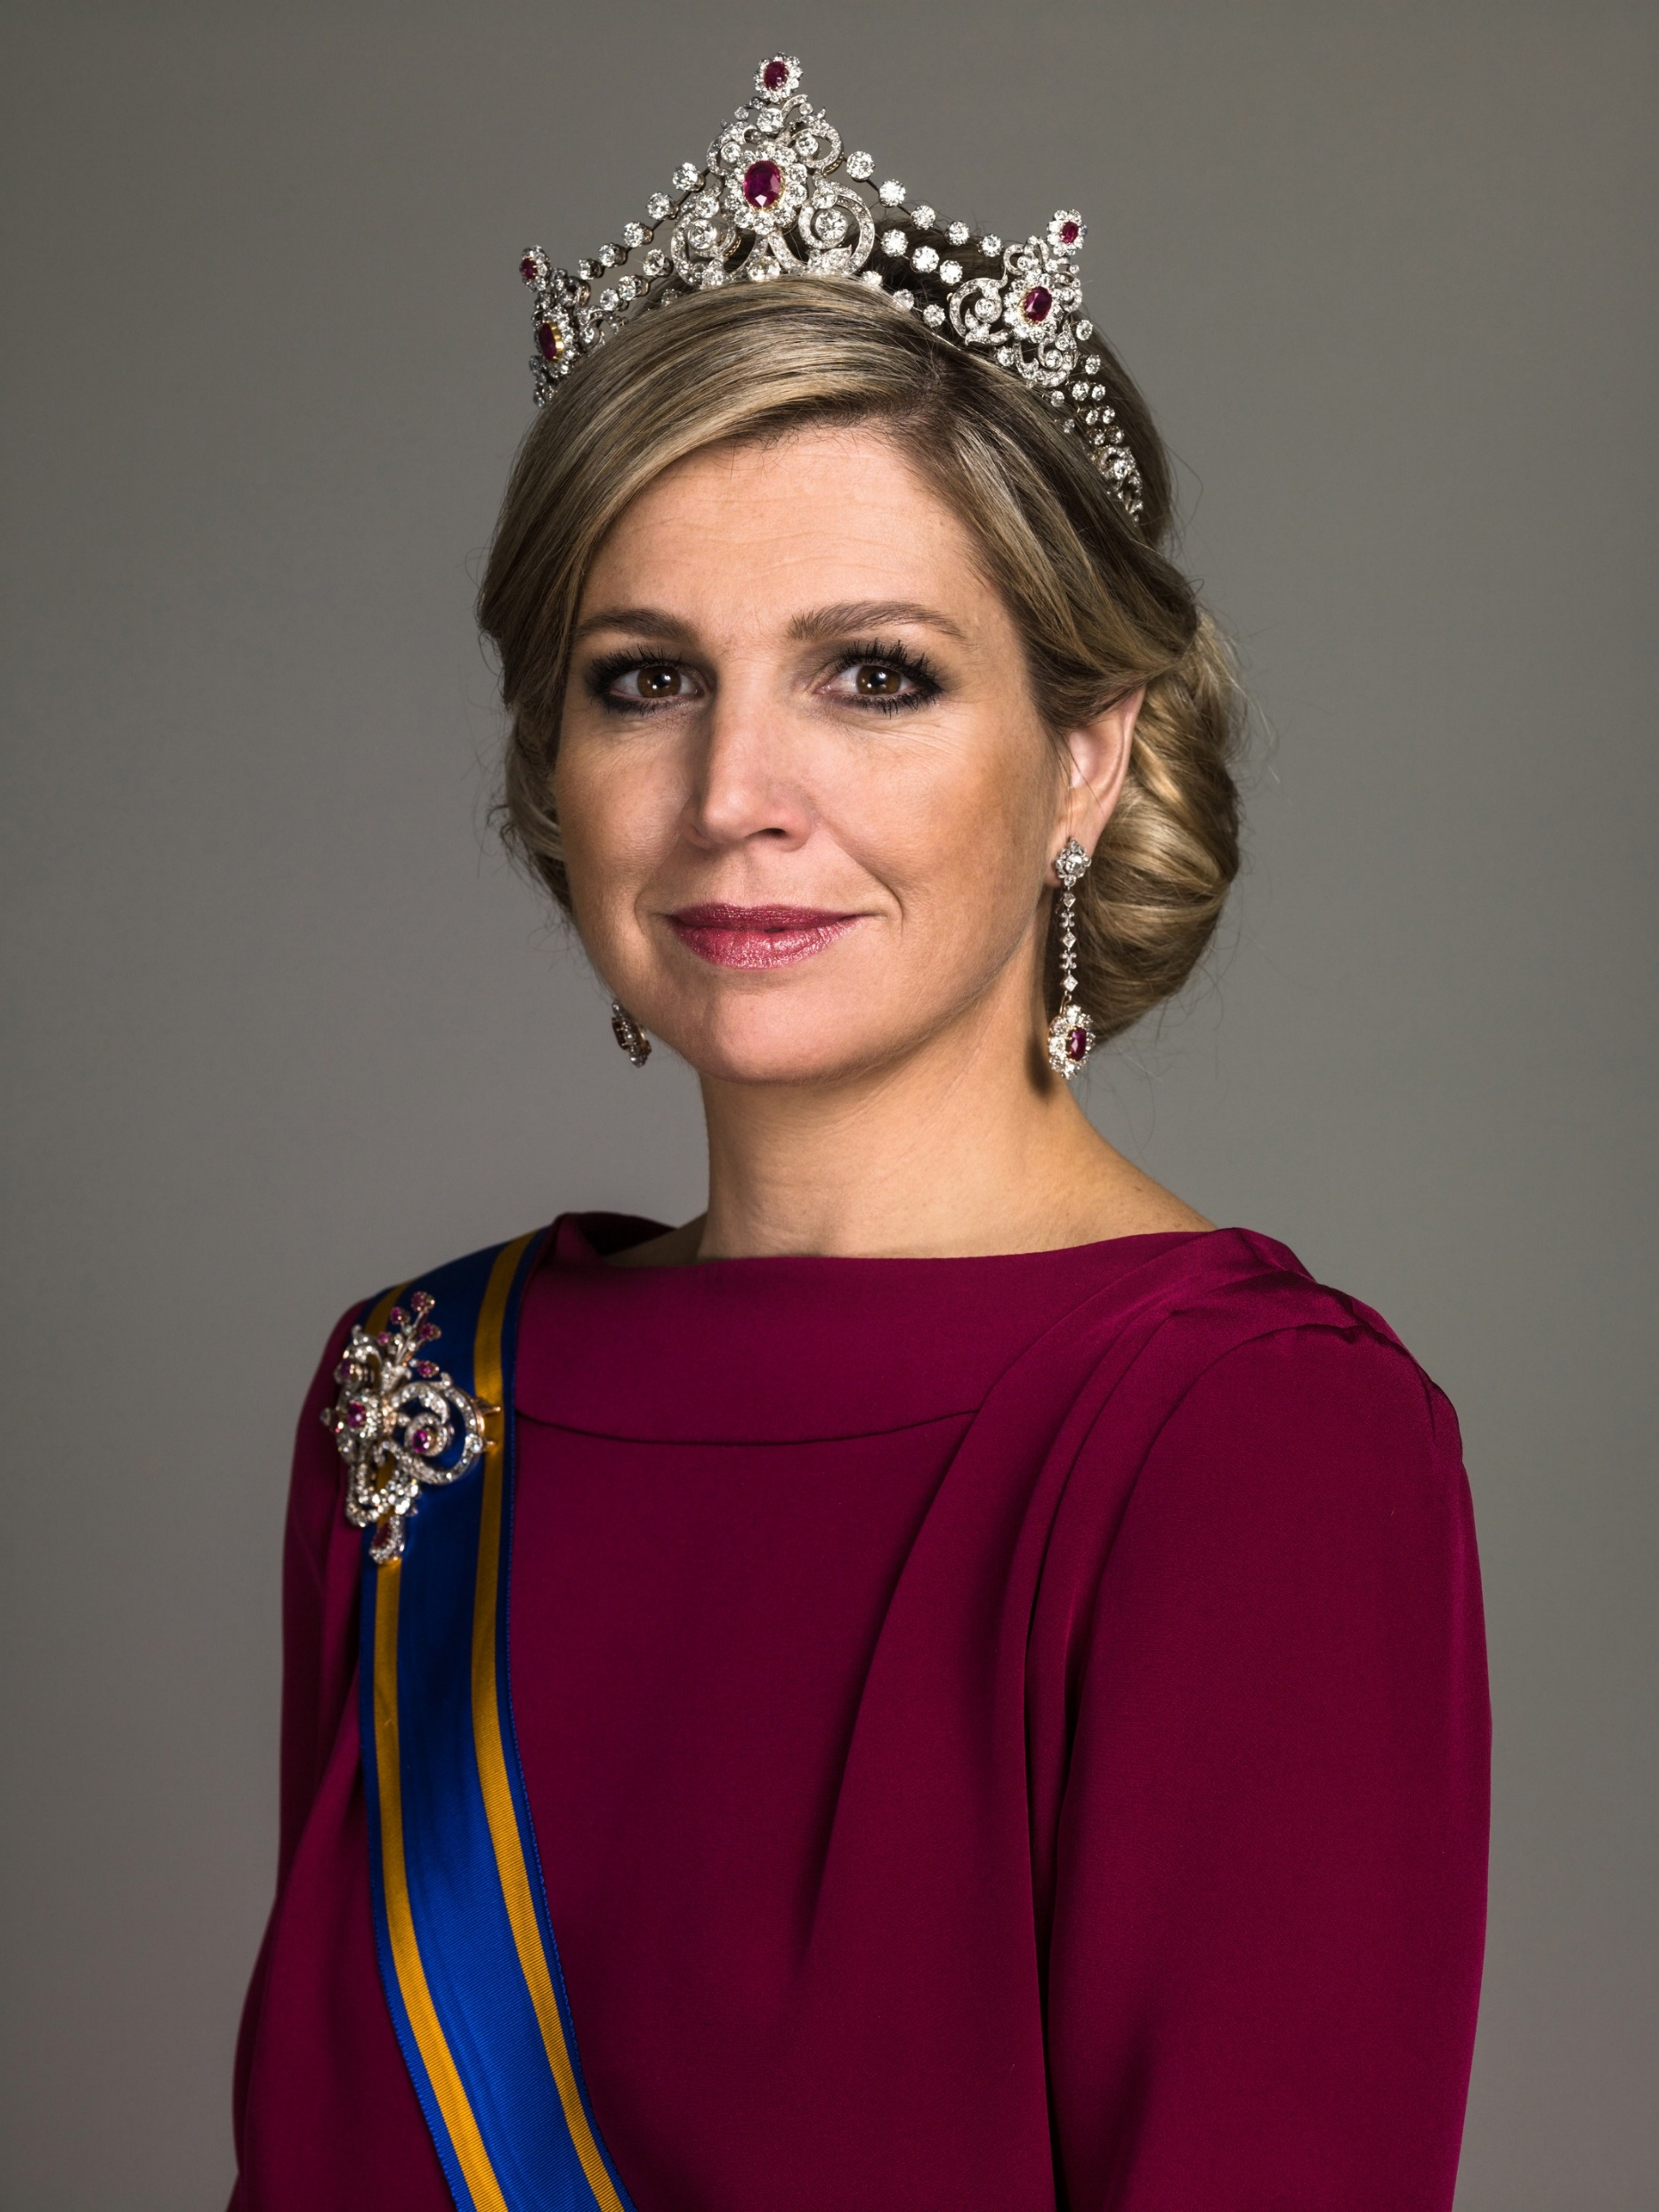
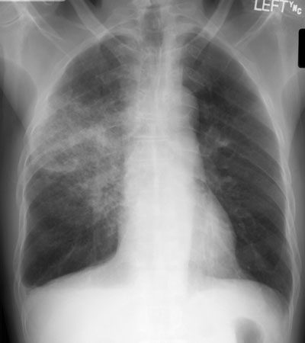


Slide 3

Diagnosing in a split second

Slide 4
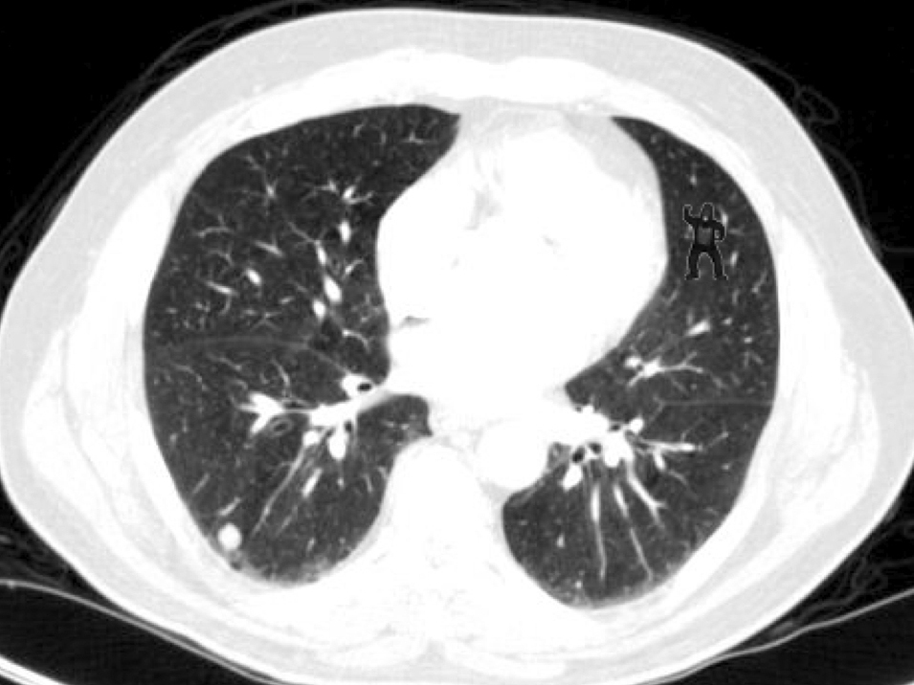

Slide 5
Biases in the diagnostic process
Observational skills are important
When insufficient information is gathered, this can lead to diagnostic errors
Cognitive biases can causes diagnostic errors.
  Availability bias, Confirmation bias
Can education about observing art be helpful to avoid bias in the diagnostic process?

Slide 6

The ‘Art of Seeing’ course
Objectively describing a visual image
Creating awareness of how a description of an image can result in different interpretations
Stimulate objective analysis of an image

Slide 7
Research questions
Do students who are trained to improve their observational skills in an art museum observe more features of patients on images?
Does attending the ‘Art of Seeing’ course result in less susceptibility to cognitive biases (i.e. confirmation bias and premature closure) in diagnostic reasoning?
Does attending the ‘Art of Seeing’ course result in better diagnostic performance?
Do the results differ for 2nd year versus 3rd year students

Slide 8
Recruitment
2nd and 3rd year BSc students
Halfway the ‘Art of Seeing’ course
  Half the students did participate, the other half did not.
Recruitment during lecture of another course
Participation online through Qualtrics questionnaire
They received a small reward for their participation (5 euro Bol.com coupon).

Slide 9
Learning phase
Test phase
Control:
Students have not yet participated in the ‘Art of Seeing’ course
All participants see 6 images of patients that they need to diagnose.
To induce bias:
3 images with a correct suggestion
3 images with an incorrect suggestion
Experimental:
Students have participated in the ‘Art of Seeing’ course
Notes:
The students would attend the course in small groups, spread out over 2 months in year 2 and spread out of 4 weeks in year 3.
Approximately half way the course, we i

Slide 10
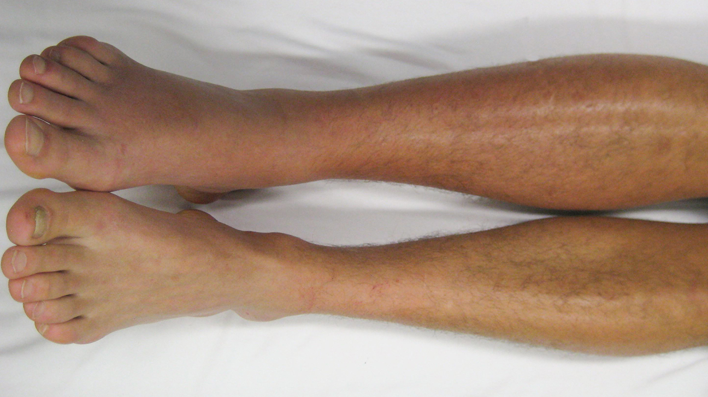
DVT or hematoma?

Slide 11
Diagnostic suggestion: Deep venous trombosis
Please list all potentially relevant features that you notice on this image.
What is the best explanation of the symptoms?
What alternative diagnoses did you consider?
How certain are you about your answer? (scale 0-10)
Notes:
All images:
Half of the students received the correct diagnostic suggestion
Half of the students received an incorrect diagnostic suggestion
All students:
Received 3 correct diagnostic suggestions
Received 3 incorrect diagnostic suggestions

Slide 12
Outcome measures
Number reported features
Accuracy of diagnostic decision
Number of alternative diagnoses
Accuracy of alternative diagnoses
Confidence level

Slide 13
Results
Participants (N=93)
  57 2nd year students
  36 3rd year students
34 (37%) male, 59 (53%) female
Age in years: mean 20.3; SD 1.22
Attended the Art of Seeing course?
  Yes: 48.4%
  No: 51.5%
Notes:
Results are very preliminary, as I only finished the data gathering a bit more than a week ago. I actually haven’t even shared the results with my co-investigators.

Slide 14
Research question 1
Do students who are trained to improve their observational skills in an art museum observe more features on images of patients?
Overall there was no significant difference
  Mean 2,57 versus 2,43, p>0.05
 | 2nd year students (N=57) mean (SD) | 3rd year students (N=36) Mean (SD) | Total (N=93) Mean (SD)
Participated in ‘Art of Seeing’ | 2,29 (1,11) | 2,89 (1,01) | 2,57 (1,24)
Not participated in ‘Art of Seeing’ | 2,38 (1,31) | 2,54 (1,01) | 2,43 (1,13)

Slide 15
Research question 2
Does attending the ‘Art of Seeing’ course result in less susceptibility to cognitive biases?
Number of features reported in cases with an incorrect suggestion:
Overall a marginally significant difference
  Mean 2,66 versus 2,40, p=0.068
 | 2nd year students (N=57) mean (SD) | 3rd year students (N=36) Mean (SD) | Total (N=93) Mean (SD)
Participated in ‘Art of Seeing’ | 2,38 (1,08) | 2,92 (1.11) | 2,66 (1.12)
Not participated in ‘Art of Seeing’ | 2,27 (1.26) | 2,71 (1.08) | 2,40 (1.22)

Slide 16
Research question 2
Does attending the ‘Art of Seeing’ course result in less susceptibility to cognitive biases?
Number of Alternative Diagnoses in cases with an incorrect suggestion:
Overall there was no significant difference
  Mean 1,50 versus 1,41, p>0.05
 | 2nd year students (N=57) mean (SD) | 3rd year students (N=36) Mean (SD) | Total (N=93) Mean (SD)
Participated in ‘Art of Seeing’ | 1,49 (1,09) | 1,51 (0.90) | 1,50 (0,99)
Not participated in ‘Art of Seeing’ | 1,29 (0.76) | 1,69 (1.15) | 1,41 (0,90)

Slide 17
Confidence measures
Diagnostic error are often attributed to overconfidence, which is related to premature closure and confirmation bias.
Overall there was no significant difference of attending the course on confidence
  Mean 5.66 versus 5.89, p>0.05
However:
 | 2nd year students (N=57) mean (SD) | 3rd year students (N=36) Mean (SD) | Total (N=93) Mean (SD)
Participated in ‘Art of Seeing’ | 5,65 (2,30) | 5,67 (2,19) | 5,66 (2,25)
Not participated in ‘Art of Seeing’ | 5,59 (2,25) | 6,54 (1,65) | 5,89 (2,12)
Notes:
This is significant

Slide 18
Confidence measures
Correct diagnostic suggestion:
Incorrect diagnostic suggestion:
 | 2nd year students (N=57) mean (SD) | 3rd year students (N=36) Mean (SD) | Total (N=93) Mean (SD)
Participated in ‘Art of Seeing’ | 5,81 (2,56) | 5,81 (1,81) | 5,81 (1,95)
Not participated in ‘Art of Seeing’ | 5,76 (2,44) | 6,73 (1,33) | 6,10 (2,17)
 | 2nd year students (N=57) mean (SD) | 3rd year students (N=36) Mean (SD) | Total (N=93) Mean (SD)
Participated in ‘Art of Seeing’ | 5,42 (2,61) | 5,52 (2,52) | 5,47 (2,55)
Not participated in ‘Art of Seeing’ | 5,45 (2,09) | 6,36 (1,91) | 5,71 (2,08)
Notes:
Both are significant

Slide 19
Research question 3
Does attending the ‘Art of Seeing’ course result in better diagnostic performance?
Overall effect not statistically significant 0,76 versus 0,69, p= 0.094, but clinically relevant?
Most likely diagnosis:
Correct diagnosis among alternative diagnosis considered:
 | 2nd year students (N=57) mean (SD) | 3rd year students (N=36) Mean (SD) | Total (N=93) Mean (SD)
Participated in ‘Art of Seeing’ | 0,58 (0,50) | 0,67 (0.47) | 0,62 (0,49)
Not participated in ‘Art of Seeing’ | 0,56 (0.49) | 0,59 (0,49) | 0,57 (0,50)
 | 2nd year students (N=57) mean (SD) | 3rd year students (N=36) Mean (SD) | Total (N=93) Mean (SD)
Participated in ‘Art of Seeing’ | 0,18 (0,39) | 0,25 (0.44) | 0,22 (0,41)
Not participated in ‘Art of Seeing’ | 0,13 (0,33) | 0,33 (0,47) | 0,19 (0,39)

Slide 20
Discussion
Preliminary data, but interesting insights!
Some evidence for positive effects of improved observational skills
  Especially in 3rd year students
Attending the ‘Art of Seeing’ course reduces the confidence in 3rd year students
No statistically significant effect on performance, but it does have clinical relevance.

Slide 21
Strengths and limitations
Strengths:
Strong quasi experimental design
Education as usual, measures for the study were seemingly unrelated
Two levels of experience included
Limitations:
Potential selection bias, most active students may have participated
Risk that the students were aware about the link with the ‘Art of Seeing’ course
Control group did not have alternative clinical reasoning education
Possibly underpowered due to a limited number of participants

Slide 22
Implications
The course seems to have positive effects on the diagnostic observation skills of students.
  Fairly strong effects for a relatively short course.
Some evidence that both performance and observational skills improve.
It is possible that the course is more suitable for 3rd year students than for 2nd year students

Slide 23
Thank you!
l.zwaan@erasmusmc.nl

