Slide 1
Media Studies
Media & Business
Notes:
Welcome to this information video for the specialization MA media and Business.
This specialization is one of the multiple MA tracks offered by the MA Media studies programme of the dept of media and communication.

Slide 2
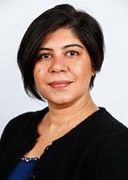
It’s great to meet you
Associate Professor
Academic Coordinator Media & Business
Dr. Vidhi Chaudhri
Notes:
Let’s get started. My name is…Vidhi Chaudhri…associate professor in the dept of M&C and the academic coordinator Media and Busines. It is my pleasure to welcome you to this presentation

Slide 3
Media & Business
Notes:
In this presentation, I will walk you through thedistinctive features of the M&B specialziation, the composition of our classroom and the curriculum, we will look at one course in some depth to help you understand our teaching methods, the importance of class discussion, and and the intersection of theory and practice.\
Finally, I will leave you with a picture of where our alumni typically end up and sources of additional information.

Slide 4
Introducing Media & Business
The programme Media & Business has two key themes:
1. How do digital media change businesses?
2. How can businesses stay relevant, compete and lead in a rapidly transforming media environment?
Notes:
The programme Media & Business has two key themes:
1. How do digital media change businesses?
Learn how the digital revolution and globalisation have transformed the media business and other industries. Examine the new business models that have been developed and the new products and services that have emerged.
2. How can businesses stay relevant, compete and lead in a rapidly transforming media environment?
Examine how businesses are responding to the challenges (e.g., growing stakeholder power, new forms of crisis, privacy, and ethics) and opportunities (e.g., crowdsourcing, dialogue, and stakeholder engagement) of the digital era that is increasingly complex and uncertain. Understand the cultural and contextual factors that shape strategic communication in the digital age.

Slide 5
Key words of the M&B programme
Social media communication (effects and influences)
Branding and identity
Communicating for social change (e.g., sustainability and CSR; social media campaigns)
Stakeholder (e.g., employee, consumer) communication
Leadership & corporate reputation
Contemporary topics (fashion brand activism; diversity and inclusion; unboxing the algorithm)
International strategic communication; cultural influences
Changes in business models/business transformations
Media entrepreneurship; and media management
Notes:
Here, you see a snapshot—by no means exhaustive—of some of the defining constructs and keywrods f the programme. What you see is a failry broadbroased progarmme with topics that are cutting edge, up to date…thst are relevant not just to study but also a good reflection of the command business changes and challenges confronting organizations in their effort to stay relevant and competitive especially in the digital era.

Slide 6
Inside the M&B classroom
Very international classroom and staff:
Current classroom: 33 nationalities, 59% non-Dutch
Current M&B staff: 12 nationalities, 63% non-Dutch
Almost 85% completes the M&B programme within one year, with an average GPA of 7,8/10 (2020-2021)
Guest lectures
Notes:
In addition to our curriculum, we have a very international classroom …..

Slide 7
Study programme
Term 1 | Term 2 | Term 3 | Term 4
Media & Business Transformations | Elective Seminar, choose from: Strategic Mass Communication Digital Media & Consumer Culture New Media Marketing & Advertising CSR Communication |  | Master Thesis
Elective Seminar*, choose from: Corporate Management with Social Media Media Economics & Media Management | Research Workshop*, choose from: Brands, Media & Identity Cultural, New Media & International Business Ethical Issues in Advertising Diversity and Inclusion in Strategic Communication Advertising, Gender & the Body Networked Datascapes in Participatory Platforms | Elective Seminar*, choose from: Social Media Campaigns Entrepreneurship in Media & Business Leadership Communication: Strategies & Trends Digital Research Methods Unboxing the Algorithm Future Studies as a Strategic Tool for Media Firms
Methods of Media Research I | Methods of Media Research II | Master Thesis
Master Class
Please visit courses.eur.nl for descriptions of all courses
*The offer of elective seminars and research workshops might be subject to change
Notes:
Mix of mandatory courses and electives each term, including content and method courses.
Formats: seminars + Research workshops
The Master Class helps stduents prepare for the thesis…..term 4 is entirely dedicated to the MA thesis.
The extensive offering of courses and the ability to carve out a thesis topic of ones interest (in consultation with the thesis supervisor) makes the programme customizable. Many of our stduents have written outstanding theses in past years tht have won awards or been presented at academic conferences, so this an important part of the MA

Slide 8
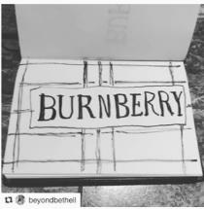
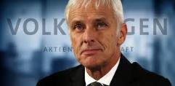
Corporate Management with Social Media
Stakeholder relations
Reputation management
Social change and advocacy
Case studies
Guest lectures
CSR and sustainability
Critically review the opportunities, peculiarities, and strengths of different social networks for corporate communication
How do social media influence, alter, and challenge corporate communication and strategic management functions?
Reflect on the practical and business implications
‘Unintended’ consequences
Crisis communication
Employee engagement
Class discussion
Notes:
Looks at how corporate comm and management functions are transformign in the digital era and the opportunitues and challenges that these developments pose for organizational reputation and survival.
We particularly focus on social mediated developments that present an interescting story of constrasts, where social media are at once a force unifier, connecting disperrsed audiences, people from across the gloabl, in real-time, enabling new forms of communication and are simultaneously part of the problem, creating anf contributing to more polarization, mis and dis information, even hate. As studnets and future professionals in media and bsuiness, we encourage our stduents to think critically and analytically about what these developments mean for organizations.
In Cmwith SM, stduents are introduced to an overview of topics that are most salient....we do so by drawing on state of the srta research, classic and comteporary cases, guest lectures, debates and discussions...in doing so, our aim is to help stduents appreciate tje intersection of theory and practice, or academia and industry, and to be able to both zoom in on micro developments while being able to zoom out and see the big picture.

Slide 9
Career fields Media & Business
What are the career fields of our M&B alumni?
Brand Manager Desperados
Marketing Intelligence Analyst
CRM Specialist
Social Media Coordinator
Digital Communications Coordinator

Slide 10
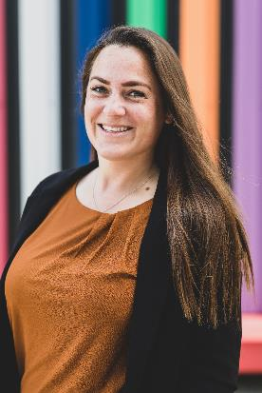
Questions about admissions?
Each applicant has their own background and details. Our Admissions Coordinator will be available through email to answer your Admission questions.
Marysia Beekes
Contact Marysia by sending an email:
Mediastudies.admission@eshcc.eur.nl
Admissions Coordinator Media & Communication

Slide 11
Other sources of information
Visit our website:
eur.nl/en/eshcc/master-media-studies
@mediastudieserasmus
Chat with current students: eur.nl/en/eshcc/contact/ chat-with-our-students
/mastermediastudies
Email us at: mediastudies.admission @eshcc.eur.nl
Notes:
Additional useful sources that I invite you to check out….

Slide 12
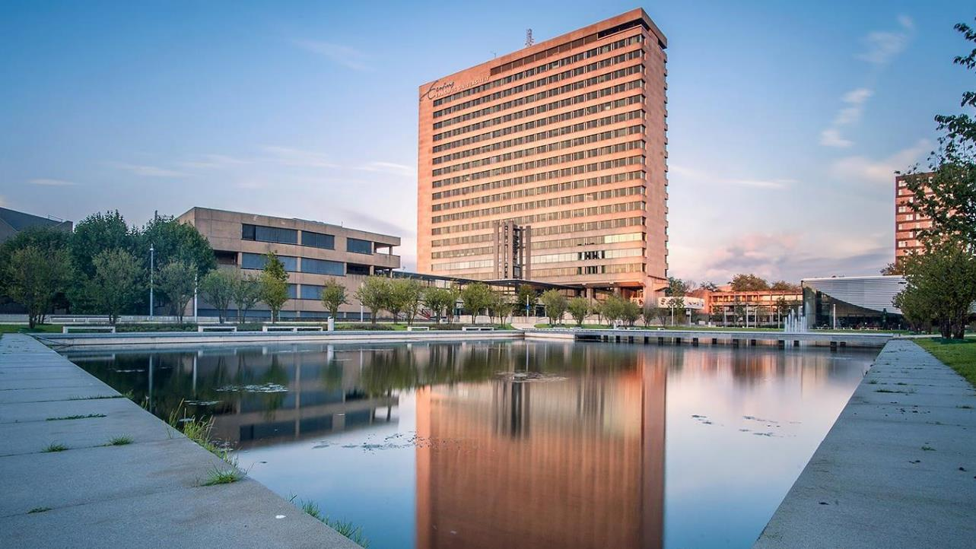
Thank you!

