Slide 1
Welcome to EUR!
All things you need to know
For incoming international students at Erasmus University Rotterdam
https://eur-nl.zoom.us/j/98885923344
2 August 2023
Notes:
1

Slide 2


Welcome!
Welkom!
Chermain Mohlmann
Orientation & Exchange Officer
Samantha Quiambao
Orientation & Exchange Officer

Slide 3
Our intention of today’s session:
Discuss practical matters for orientation step by step and give you the opportunity to ask whatever you like
Be confident about what steps to take when it comes to practical matters for your arrival in Rotterdam & EUR
We will not discuss admissions or immigration related questions
We will say EUR a lot! What does EUR stand for? Erasmus University Rotterdam
We will hold space for questions about practical matters
Notes:
3

Slide 4

What are we going to cover
You’ve arrived, now what? Next steps in the Netherlands
Overview Orientation Activities
City Hall Registration & One Stop Shops
Housing & Insurance Information
Q&A
Contact us!
Notes:
4

Slide 5
First some questions…
Where are you from?
Are you already in the Netherlands?
What would you like to discover today?

Slide 6

Orientation Activities
One Stop Shops | Registration to City Hall & Various resources like ISIC, AON, LTC, ESN | August & September| Register online!
Ikea Service | Have you arrived but need more supplies? We hope to take you to Ikea with us! | Register online!
Bicycle Lessons | Learn the Dutch way when it comes to
riding a bike | Dates to come!
Notes:
6

Slide 7
What happens if we cannot have One Stop Shops?
Are you arriving after the One Stop Shops are done? You will have to go to the City Hall for your registration. Remember, you must do the city hall registration in the city you live in!
Check this link on how to make an appointment.
*Need help with the Dutch?
Use Chrome browser &
Right click + translate
Notes:
7

Slide 8
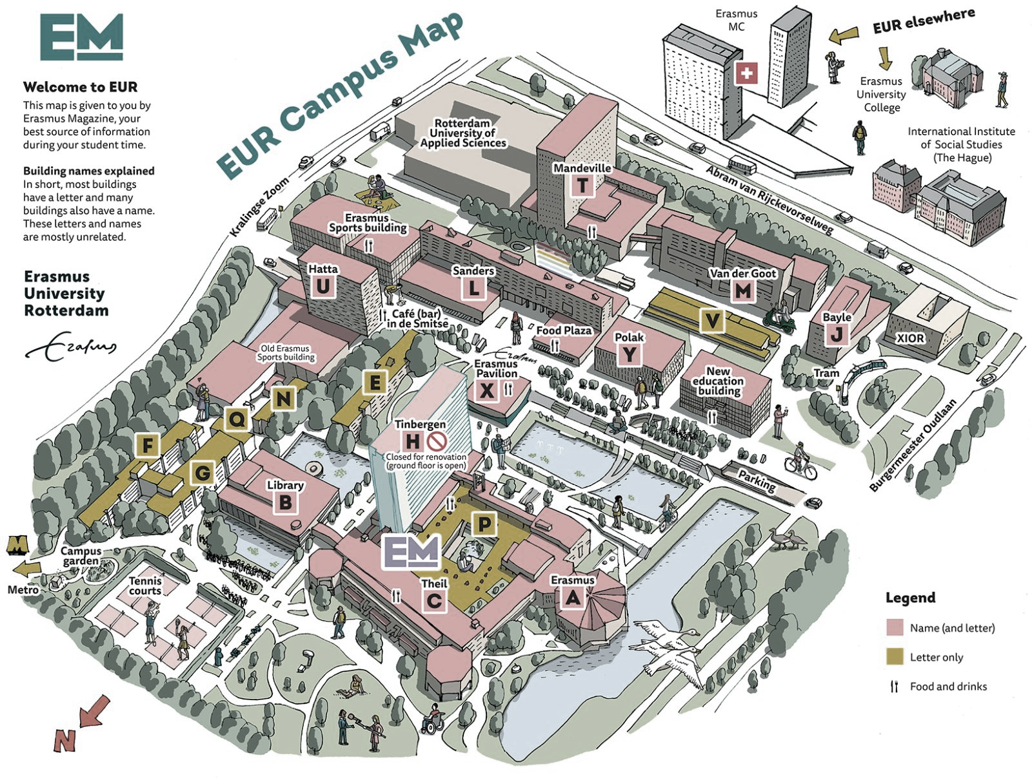

Slide 9
Transportation in the Netherlands
Public Transport Card w/ Discount for International Students
  provide international students easy access to all forms of transport in the Netherlands. With Student Mobility you are able to receive a customized public transport card (+ an ISIC Student-ID) with special discounts for international students! You can use
  this card for train, tram, metro and bus.
Notes:
9

Slide 10
Transportation in the Netherlands
Free Train Service with ISIC
  International students coming to Rotterdam for the new academic year 23/24 are eligible to receive one train voucher from the airport Schiphol to Rotterdam Central station
  Not living in Rotterdam?
  You can also use this ticket to go to nearby cities,
  such as Den Haag.
  Pleas keep in mind, you will receive
  your train ticket a few days after
  you register. Therefore please
  do not wait until
  the last minute!
Notes:
10

Slide 11

During arrival
Registering at City Hall
You can do so during the One Stop Shops
Opening a bank account
Can be done online easily via ABN Ambro or Bunq
Travelling to Rotterdam
Use 9292ov app
Use the NS app
Notes:
11

Slide 12
Transportation in the Netherlands
Important apps you need to have!
  Google Maps
  9292
  NS
  NS - International
Notes:
12

Slide 13

Housing & Insurance
Want to receive housing tips?
Send an email to studenthousing@eur.nl
Housing
Check our website www.eur.nl/housing
Insurance we recommend Aon Student Insurance. You can already do this at home!
Check our website
https://www.eur.nl/en/education/study-rotterdam/living-here/insurance
Notes:
13

Slide 14
Finding accommodation timely is important because…
No house = (non necessary) stress
Any stay in Rotterdam over 4 months requires registration at City Hall
No living address = no registration =
no BSN = no legal stay
Note:
We help all first year with registration at our “One Stop Shops” during the orientation period.
Check the website.
Notes:
14

Slide 15
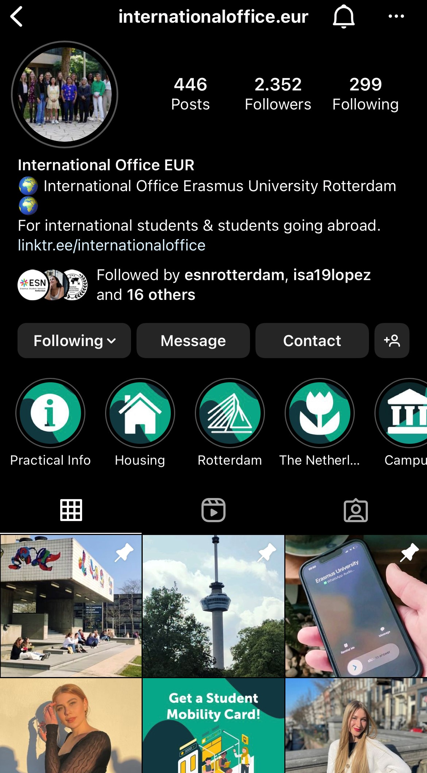
Stay Up-to-Date!
Follow our Instagram for updates! @internationaloffice.eur
You’ll find more resources, special
q&a’s and more!

Slide 16
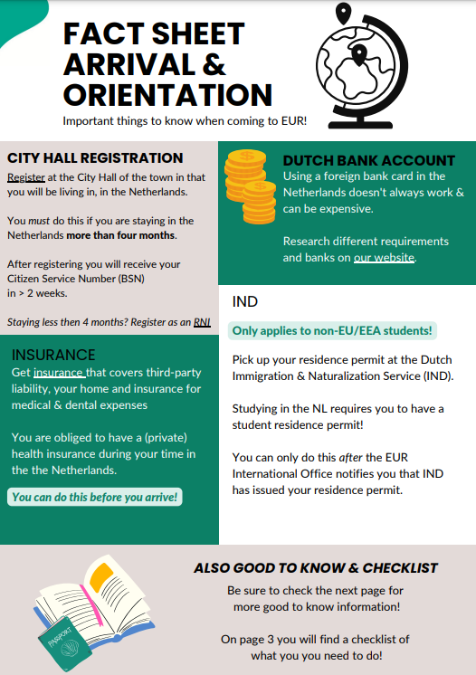
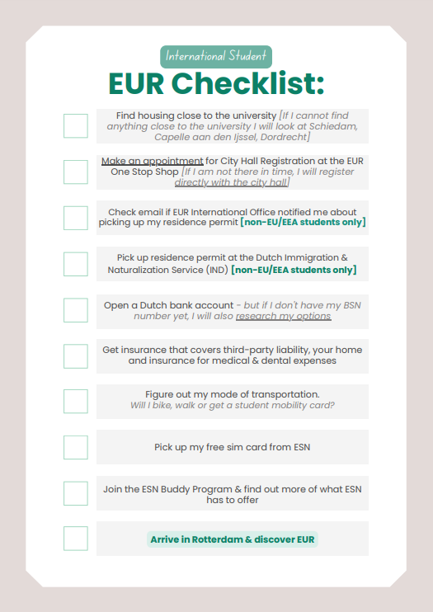
Fact Sheet & Checklist
Need more info? Check out our fact sheet & checklist here

Slide 17
See you at International Day
Eurekaweek!
Notes:
17

Slide 18
Q&A
Notes:
18

Slide 19
International Office Contact Information
Questions? Contact the Erasmus Student Service Centre or the International Office
Follow our Instagram for updates! @internationaloffice.eur
Have more questions about orientation? You can contact us directly at orientation@eur.nl
Have more questions about immigration? You can contact us directly at immigration@eur.nl
Notes:
19

