Slide 1
Information about your next academic year
B2 -> B3
March 2023, Loeki Lauw

Slide 2
Preface
Not a lot of time & a lot of information
    Some information not completely available yet, or under revision
    Dates and times mentioned by approximation
Canvas course
    Modules with more elaborate information
    Discussions -> questions

Slide 3
01A Overview of this information session
3.1
Minor
3.3
Elective
3.4 - 3.6
Specialization
3.7
Bachelor thesis

Slide 4
01B General structure and calendar
3.1
3.3
Elective
3.4
Specialization 3.4C & 3.4P
3.7
Bachelor thesis
Nov/Dec
3.5
3.6
Specialization 3.5C & 3.5P
Specialization 3.6C & 3.6P
Jan/Feb
Feb/Mar
Mar/Apr
Apr/Jun
Minor
Sept/Oct/Nov

Slide 5
01B General structure and calendar
3.1
3.3
Elective
3.4
Specialization 3.4C & 3.4P
3.7
Bachelor thesis
Nov/Dec
3.5
3.6
Specialization 3.5C & 3.5P
Specialization 3.6C & 3.6P
Jan/Feb
Feb/Mar
Mar/Apr
Apr/Jun
BSc Phil SD
Sept/Oct/Nov
Exemption
https://www.eur.nl/bachelor/dual-degree-arts-and-sciences
myeur.nl -> R&R -> Article 10: “Exemption for the minor may be granted based on….”

Slide 6
01B General structure and calendar
3.1
3.3
Exchange
3.4
Specialization 3.4C & 3.4P
3.7
Bachelor thesis
Nov/Dec
3.5
3.6
Specialization 3.5C & 3.5P
Specialization 3.6C & 3.6P
Jan/Feb
Feb/Mar
Mar/Apr
Apr/Jun
Exchange
Sept/Oct/Nov
https://www.eur.nl/en/essb/education/exchange/outgoing-exchange
Nominating process, info session March

Slide 7
01B General structure and calendar: No internship for ECs
3.1
3.3
Elective
3.4
Specialization 3.4C & 3.4P
3.7
Bachelor thesis
Nov/Dec
3.5
3.6
Specialization 3.5C & 3.5P
Specialization 3.6C & 3.6P
Jan/Feb
Feb/Mar
Mar/Apr
Apr/Jun
Minor
Sept/Oct/Nov
Program already provides for 60 ECs
Tips on Canvas
Internship during masters -> B3 information session

Slide 8
Minors

Slide 9
02A Minors
3.1
3.3
3.4 - 3.6
3.7
15 EC
Admission requirements: Have done B2 at least once. Discuss with a student advisor if you haven't completed B2 fully.
When and how: Information during March, also eur.nl/minor, sign up around beginning of May, likely first come first serve
Options
    EUR PSY:
        Cross-Cultural Psychology
        Know Thyself
    EUR & TU Delft & Leiden University
    Somewhere else -> Examination Board

Slide 10
02B Minors
3.1
3.3
3.4 - 3.6
3.7
Cross-Cultural Psychology
    https://eur.cloud.panopto.eu/Panopto/Pages/Viewer.aspx?id=856260e6-4bce-42f2-92c7-afb900a7329c
Know Thyself
    TBA

Slide 11
Electives

Slide 12
03A Electives
3.1
3.3
3.4 - 3.6
3.7
5 EC
Admission requirements: Have done B2 at least once. Discuss with a student advisor if you haven't completed B2 fully.
When and how: Sign up around September, likely first come first serve

Slide 13
03A Electives
3.1
3.3
3.4 - 3.6
3.7
Options
    Forensic Psychology
    Legal Psychology
    Local to Global
    Motivation, Self-Regulation, and Performance
    Pain: Psychological Factors and Treatments
    Psychological Science
    [Dutch] Effectieve Bestanddelen van Psychotherapie
Course guide information on Canvas

Slide 14
03B Electives
3.1
3.3
3.4 - 3.6
3.7
Forensic Psychology & Legal Psychology
    https://eur.cloud.panopto.eu/Panopto/Pages/Viewer.aspx?id=58cf695a-6978-483a-a88f-afb700f20cbe

Slide 15
03B Electives
3.1
3.3
3.4 - 3.6
3.7
Local to Global (subjective to change)
“ | Whilst the 21st century has advanced our capabilities in many ways, that too brings with it many societal concerns, such as the poverty, diversity, immigration, global warming, media usage and well-being, to name a few. During this elective, students will explore societal issues of the 21st century and more importantly, in groups of five, collaborate with the goal of creating realistic and feasible solutions to prevent/alleviate these issues. Each group of students will be paired up with an academic supervisor to guide them along the way of contacting external stakeholders, measuring the effects of their proposed solution, presenting their findings and ‘giving back’ to the community in a way they see fit, based on the content of their project. | ”

Slide 16
03B Electives
3.1
3.3
3.4 - 3.6
3.7
Local to Global (subjective to change)
“ | 1. Work together with a) peers from various backgrounds on the same self-initiated project and b) appropriate external parties in the community. Reflect upon individual and group collaboration skills. 2. Identify a societal problem experienced locally and/or globally and propose feasible and creative solutions to alleviate said issue. 3. Explain the underlying mechanisms and reasons behind this societal problem. Investigate the possible effects of the proposed solution. Form a well-supported conclusion concerning the research question. This will account for the academic component of assessment. 4. Based on lessons learned from your findings, ‘give back’ to the community. Format depending on the project at hand. Examples include workshops, newspaper articles, flyers etc. This will account for the non-academic component of assessment. | ”

Slide 17

03B Electives
3.1
3.3
3.4 - 3.6
3.7
Motivation, Self-Regulation and Performance
What is motivation / self-regulation?
How does motivation / self-regulation relate to performance?
Different theories applied to health/sports/work/educational context, for instance:
Does focusing on winning vs. focusing on not losing make a difference for performance?
Notes:
Slide 1: Are you interested in understanding why some people perform better than others on work or study related tasks? Or interested in understanding why some people manage to exercise all the time and eat a healthy diet, while others find it difficult to deal with the temptation of fast-food? Why is it sometimes difficult to make the effort to take on a task? And why do most of us sometimes postpone tasks even though we know we will regret this later? These are just some of the central questions that we will study during the elective motivation, self-regulation, and performance.

Slide 18
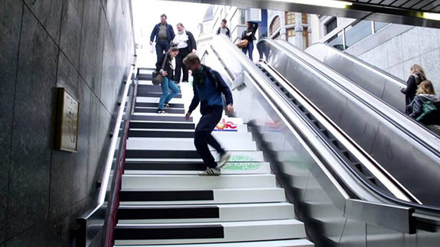
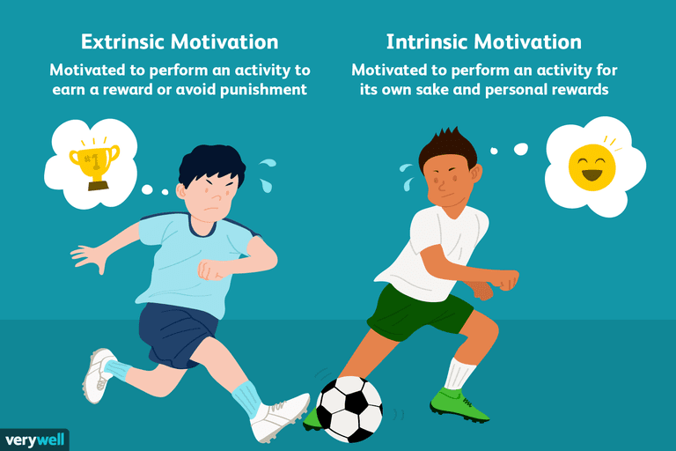

03B Electives
3.1
3.3
3.4 - 3.6
3.7
Motivation, Self-Regulation and Performance
How can coaches / teachers / managers increase intrinsic motivation?
Can we seduce (nudge) people to live healthier?
What strategies can be used to deal with self-regulatory failure?
Notes:
Slide 2: These questions are all related to being able to self-regulate and understanding how and what motivates people. So, in this elective, you will be provided with an overview of the major theoretical frameworks behind understanding what self-regulation and motivation are, but also how they are related to performance, for example in sports, at work, or when dealing with a client in a clinical context. You will be reading empirical research on these topics to understand the theoretical frameworks behind them. This includes research on theories, such as control theory, social cognitive theory, achievement goal theory, self-determination theory, and regulatory focus.

Slide 19
03B Electives
3.1
3.3
3.4 - 3.6
3.7
Motivation, Self-Regulation and Performance
5 tutorial meetings and 4 lectures
    Motivation, nudging, self-regulation, ego-depletion, approaching/avoiding goals, willpower, procrastination
    Multiple choice exam
    Group assignment (in groups of 2 students)
    Design nudge and apply theories on self-regulation and motivation to situations in daily life (e.g., losing weight, smoking cessation, regular physical activity)
Notes:
Slide 3: Besides reading and studying about these theories related to self-regulation and motivation, this course will also address more practical questions using these theories. During the tutorials and lectures, you will, for example, work on problems and try to understand why we procrastinate and how we deal with situations when we fail to self-regulate. Also, you will look into ways managers, educators, or coaches can help others to be more intrinsically motivated, and lastly, understand how we can nudge people to make more healthier choices or make other favorable decisions.
Slide 4: This elective is built around 5 tutorials and has 4 lectures. At the end of the elective, there is a multiple-choice exam with questions about the theories and the findings from the empirical studies that you have been reading throughout the course. Besides the exam, you will be working on a group assignment in pairs for which you are asked to come up with a nudge for a self-regulation failure and apply a theory to such a situation from daily life. Overall, students generally find the course a lot of reading of academic articles, but they enjoy learning about these theories because they provide them with a solid background that they can apply to different fields of psychology, for example, organizational, clinical, or sports psychology. I’m looking forward to welcoming you to this course later this year!

Slide 20
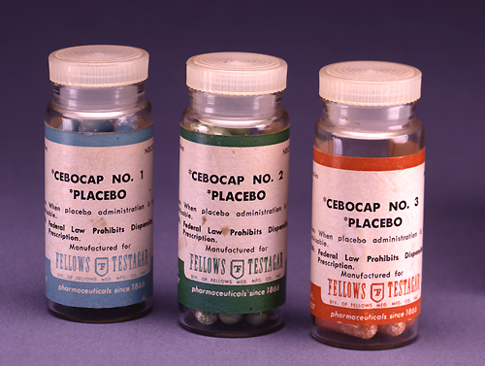
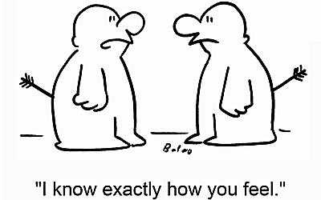
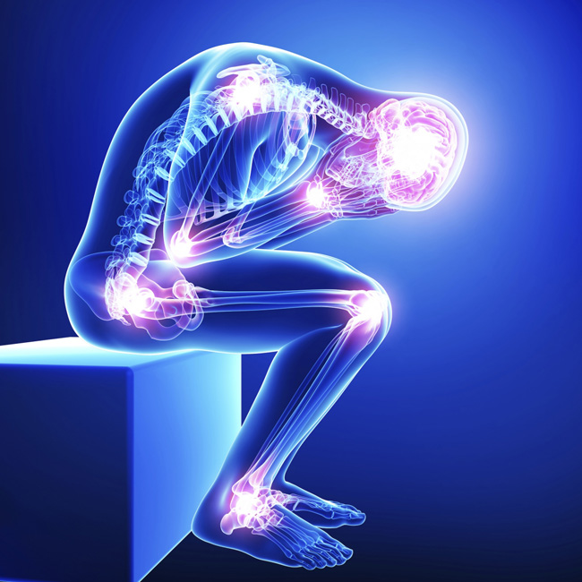
03B Electives
3.1
3.3
3.4 - 3.6
3.7
Pain: Psychological Factors and Treatments
What is the neuro-psycho-biological basis of pain?
How can we influence pain with our thoughts, emotions, behavior?
How can we treat pain with psychological approaches?

Slide 21
03B Electives
3.1
3.3
3.4 - 3.6
3.7
Pain: Psychological Factors and Treatments
Two books (but only a few chapters):
  McMahon, S.B. & Koltzenburg, M. (2013). Wall and Melzack’s Textbook of Pain (6th Edition). Amsterdam, Elsevier. (available in study landscape)
  Al’Absi, M. & Flaten, M.A. (2016). The Neuroscience of Pain, Stress, and Emotion. Amsterdam, Academic Press. (Chapters available in PsyWeb)
Focus on scientific papers (all on Canvas)
Exam:
  approx. 45 multiple choice (a, b, c, d) questions (IN ENGLISH!)
  Exam topics: literature mentioned in the course guide, and the lectures (15%)

Slide 22
03B Electives
3.1
3.3
3.4 - 3.6
3.7
Pain: Psychological Factors and Treatments
Pain – What is it?
  Definitions, Terminology, (Neuro-)Physiological Basis
  How can we investigate pain in the lab?
    Experimental Pain Research Paradigms
    Measurements of Pain (in the clinic and in the lab)
Emotional influences on pain
  How do positive vs. negative emotions influence our pain?
  What is the relationship between Stress, Anxiety and Pain
  Why do we show pain in our face and what‘s the function of this facial expression of pain?
Cognitive influences on pain
  What is the placebo-nocebo effect?
  How do expectation and experience influence our pain?
Psychological treatments of pain
  How can we treat pain with cognitive-behavioral approaches?
  Is there an exposure therapy for pain?
  Can we really regulate our pain just with our thinking and feeling?

Slide 23

03B Electives
3.1
3.3
3.4 - 3.6
3.7
Pain: Psychological Factors and Treatments
What students said:
One of my favorite courses, very clear structure | Too much neuroscience
Fantastisch keuzevak, onwijs interessant en zeer relevant voor Psychologie. | Expected it to be more clinically oriented
Super interessant vak! Het enthousiasme van de coördinator draagt er ook zeker aan bij dat het leuk wordt om erover te leren
Work in progress:
Will try to get a clinician on board for clinical topics!

Slide 24

03B Electives
3.1
3.3
3.4 - 3.6
3.7
Pain: Psychological Factors and Treatments
Is this course something for you?
Interest in psychological aspects of a phenomenon widely seen as purely medical
Interest in experimental studies
Interest in some brain research

Slide 25
03B Electives
3.1
3.3
3.4 - 3.6
3.7
Psychological Science
    https://eur.cloud.panopto.eu/Panopto/Pages/Viewer.aspx?id=a3abfc0e-4580-4ea7-aee7-afb6010c0ab9

Slide 26
03B Electives
3.1
3.3
3.4 - 3.6
3.7
[Dutch] Effectieve Bestanddelen van Psychotherapie
“ | De medisch psycholoog werkt vanuit de visie dat somatische, psychologische en sociale aspecten bij elke aandoening een rol spelen. Vragen die o.a. aan bod komen zijn: Waarom zouden somatische patiënten eigenlijk gebaat kunnen zijn bij een psychologische behandeling? Voor welke patiënten is een psychologische behandeling geschikt (of noodzakelijk)? Welke vorm van psychologische behandeling biedt je een patiënt aan? Hoe motiveer je patiënten voor psychologische begeleiding? Wanneer kies je voor een psychologische behandeling en wanneer voor medicamenteuze therapie? Begin je standaard bij elke patiënt aan een eerstelijns psychologische behandeling, of kies je op basis van de kenmerken van de patiënt gelijk voor een tweede- of derdelijns zorgaanbod? Kan je … | ”

Slide 27
Specializations

Slide 28
04A Specializations
3.1
3.3
3.4 - 3.6
3.7
3 Courses, 3 practicals, 3x6 + 3x2 = 24 EC
Admission requirements: B1 and B2 completed, or…
    Canvas -> Modules -> Admission, sign up, resits page
When and how:
    Sign up at end of this academic year, procedure embedded in practical 2.8
    Canvas -> Modules -> Admission, sign up, resits page

Slide 29
04A Specializations
3.1
3.3
3.4 - 3.6
3.7
Your choice of specialization might influence your future master options and career options
Consider:
    Research, practice, both?
    Which domain of psychology?
    Information session B3 students about master
    Master Open Day EUR
    Ask student advisor, tutor, career advisor services EUR (myeur.nl), and so on

Slide 30
04A Specializations
3.1
3.3
3.4 - 3.6
3.7
Options
    Brain & Cognition
    Clinical Psychology
    Education and Developmental Psychology
    Work & Organizational Psychology

Slide 31
04B Specializations
3.1
3.3
3.4 - 3.6
3.7
Brain & Cognition
    https://eur.cloud.panopto.eu/Panopto/Pages/Viewer.aspx?id=00eae406-a7ce-4b83-b0db-afb6010c0a81
Notes:
https://liveeur-my.sharepoint.com/personal/26717hpe_eur_nl/_layouts/15/stream.aspx?id=%2Fpersonal%2F26717hpe%5Feur%5Fnl%2FDocuments%2FDocuments%2FWERK%2FONDERWIJS%2FBa3VoorlichtingBC%2Emkv&ct=1677508616772&or=OWA-NT&cid=340de299-f3b3-9fe9-a2c3-1e541fc7ce6c&ga=1

Slide 32
04B Specializations
3.1
3.3
3.4 - 3.6
3.7
Clinical Psychology
    https://eur.cloud.panopto.eu/Panopto/Pages/Viewer.aspx?id=6e8da540-2b2d-4d16-83a6-afb8012fb604

Slide 33
04B Specializations
3.1
3.3
3.4 - 3.6
3.7
Educational Psychology
    https://eur.cloud.panopto.eu/Panopto/Pages/Viewer.aspx?id=87d7d3c7-2cf2-485d-87e7-afb700feec01

Slide 34
04B Specializations
3.1
3.3
3.4 - 3.6
3.7
Work & Organizational Psychology
    https://eur.cloud.panopto.eu/Panopto/Pages/Viewer.aspx?id=20518e7d-0345-4e2c-bdfc-afb700e999da

Slide 35
Bachelor
Thesis

Slide 36

05A Bachelor Thesis
3.1
3.3
3.4 - 3.6
3.7
The ‘crown’ of your bachelor period, 16 EC
Admission requirements: Completed B1 and B2, and finished at least 1 course and 1 practical of the specialization courses. Contact a student advisor if you haven't completed all of the 3.4-3.6 courses and practicals.
When and how: A select group of supervisors will offer topics. More information will be announced during March to B3 students.

Slide 37
05A Bachelor Thesis
3.1
3.3
3.4 - 3.6
3.7
Options
    Empirical research (elective Psychological Science)
    Literature review

Slide 38
05B At the end…
3.1
3.3
3.4 - 3.6
3.7
 | EC
exchange | 15 | minor / DD phil / exemp
 | 5 | elective
 | 6 | 3.4C
 | 2 | 3.4P
 | 6 | 3.5C
 | 2 | 3.5P
 | 6 | 3.6C
 | 2 | 3.6P
 | 16 | bachelor thesis
 | 60

Slide 39
Sources / advice
Canvas information course, Discussions for questions
Education and Examination Regulations (EER), Rules and Regulations (R&R)
courses.eur.nl
Information sessions B3 (Monday 6th March)
EUR Masters Open Day (Saturday 25th March)
Student advisors, career advisors (myeur.nl)

