Slide 1
Inclusive Groupwork
Self-reflection and communication skills for working in diverse groups
Notes:
The power point gives indication for how much time a certain activity will require, this can be adjusted to meet the amount of time the class allows.
NB: There are a few exercises that can be assigned/prepared before class. Pp. 5 & 11

Slide 2
Workshop outline
What is a team/group?
Who Owns the Hippo?
Reflection
Creating psychological safety in diverse teams
Break
Team Roles
Inclusive Communication
Creating a team charter

Slide 3
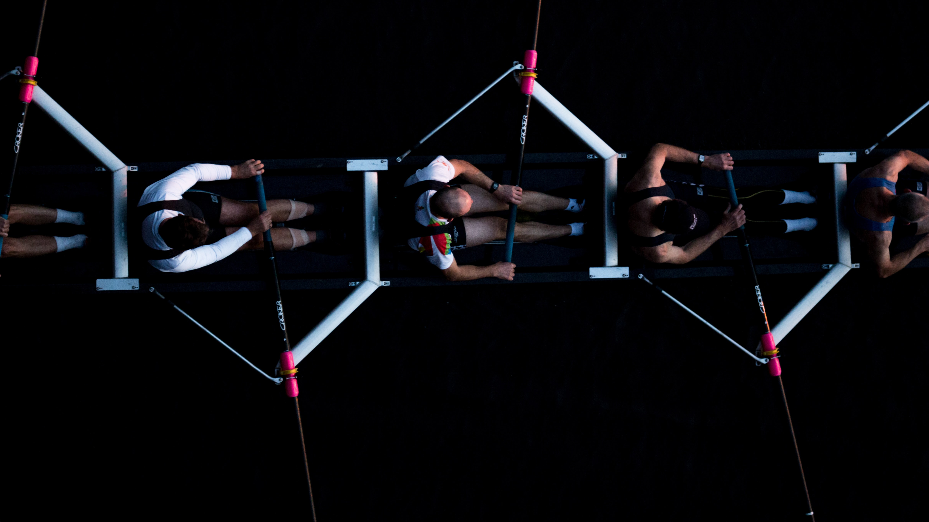
What is a team/group?
Any working group can be labelled
“a team”
… But are you really
a team?

Slide 4
What is a team/group?
Two constitutive elements of a team:
1. Synergy – general cooperation among team members
Result is greater than the sum of each individual’s work outcome
2. Clear-cut goals and objectives
Based on commonly understood aims of the team’s activities
These are necessary conditions but not sufficient on their own
Notes:
1. General cooperation among team members results in a work outcome greater than the sum of each individual’s work outcome – i.e. cooperation results in an obvious advantage for the teamwork. This can be expressed as a cooperative benefit (synergy)
2. As a part of the ongoing processes in the team, both in the team as a whole and for each member of the team, there are clear cut goals and objectives for activities, based on commonly understood aims of the team’s activities. Goals and objectives formulated and conceptualized in this way have a necessary impact on the work, in order to create the desired results. These two properties taken together can be considered as the essentials of teamwork from which the other prerequisites for teamwork can be deduced
https://journals.sagepub.com/doi/pdf/10.7227/JACE.10.2.3

Slide 5
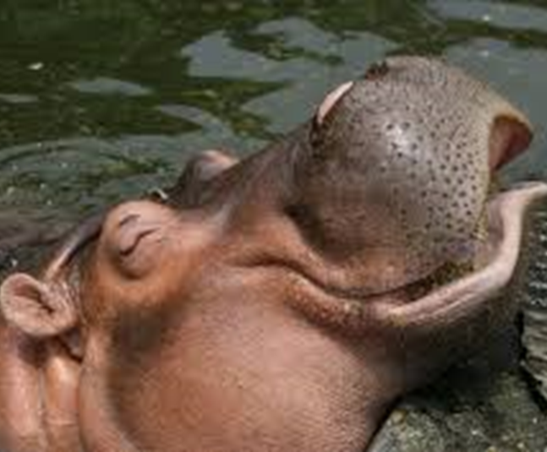
Who owns the
hippo?
10-15 mins
Teams
Notes:
AIM: To let students understand and practice teamwork, and consider issues of inclusion/exclusion/equity
STEPS:
1. Split your class into teams of 5, preferably the teams' students will be in for the course projects if you have teams of 5
2. Assign 3 members of each team the role of “native speaker” and 2 the role of “non-native speaker”. It is best to consider BEFORE class who to give the role of “non-native speaker” and to give it to students who may not have much experience being in the minority. Fill in the teams in the excel sheet labeled “Teams“
3. Distribute, either via email, if the class is online, or on cards the cues to the respective members of the teams. Each team member should receive 4 cues (see “Teams and distribution of cues” excel sheet)
4. Explain the game to the class using the following slides
Online: send teams to breakout rooms.
In class send teams into the far corners of the room.
6 Give the teams 10 mins to solve the puzzle.
Things to keep in mind for tutors:
Be strict on the time and give them regular reminders of how much time they have left. The time pressure tends to highlight areas of effective or non-effective teamwork

Slide 6
You will work in teams to solve a puzzle based on a set of cues that the members of each team receive
The scenario :
Five people are sitting in a row. Each person has a favorite color, a chocolate bar, a pet, a hobby, and a place to go on vacation.
Your task:
It is your job as a team to find out who “owns” the hippo.
You need to reach consensus in your team. As soon as you reach consensus raise your hands/return to the main zoom room
Team exercise – Who owns the hippo?
Notes:
Teams have a max of 10 minutes. The first team to be finish “wins”.

Slide 7
Two roles within the team
“native” speakers: Can discuss everything in any modality “Use whiteboard in breakout room or create shared doc.
non-native” speakers: Can only handwrite only write physically on paper and show it to camera/hold it up for your group.
(are NOT allowed to type in the group chat, email, or speak). You may privately chat with the other non-native speaker on your team.
Notes:
Check understanding with students:
who is a non-native speaker?
what can you do?
what can’t you do ?

Slide 8
Overall Solution
 | 1 | 2 | 3 | 4 | 5
Color | Lilac | Blue | Pink | Green | Purple
Name | Lucy | Jo | Hannah | Jessica | Georgina
Choco | Twix | Bounty | Mars | Milky Way | Snickers
Pet | Rabbit | Puppy |  | Horse | Hamster
Hobby | Tennis | Horse riding | Bowling | Skiing | Swimming
Holiday | Maledives | Tobago | Florida | Australia | Canada

Slide 9
Group Reflection: What makes a group work?
What worked well in your group?
What did not work well?
How did the “non-native” speakers' experiences differ from that of the “native speakers”?
Which skills are needed for effective group work?
10 mins
teams/class discussion
Notes:
Steps:
Give students several minutes to reflect individually on the exercise
Ask students to share their answers to these questions with the group
Ask several students from different groups to share their answers to the respective questions with the whole class
During a group work project, the teacher should encourage/structure weekly reflection sessions for students.

Slide 10
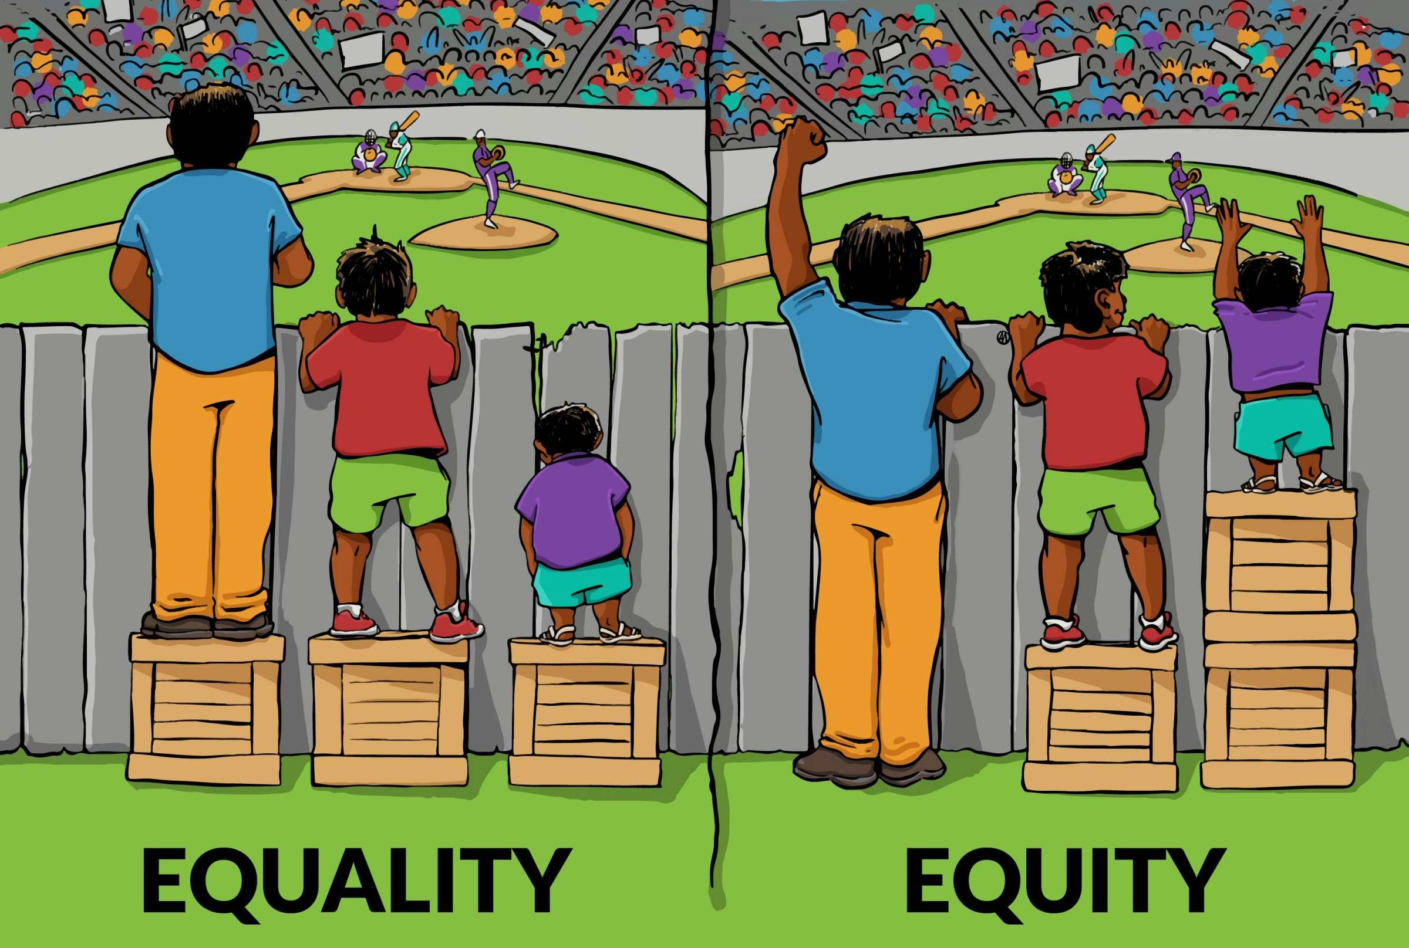
Was the exercise “fair”
Notes:
Ask the group if they found the exercise “fair”
Explain the difference between “Equality”/“Equity”
What's the Difference?
Equality means each individual or group of people is given the same resources or opportunities.
Equity recognizes that each person has different circumstances and allocates the exact resources and opportunities needed to reach an equal outcome.

Slide 11
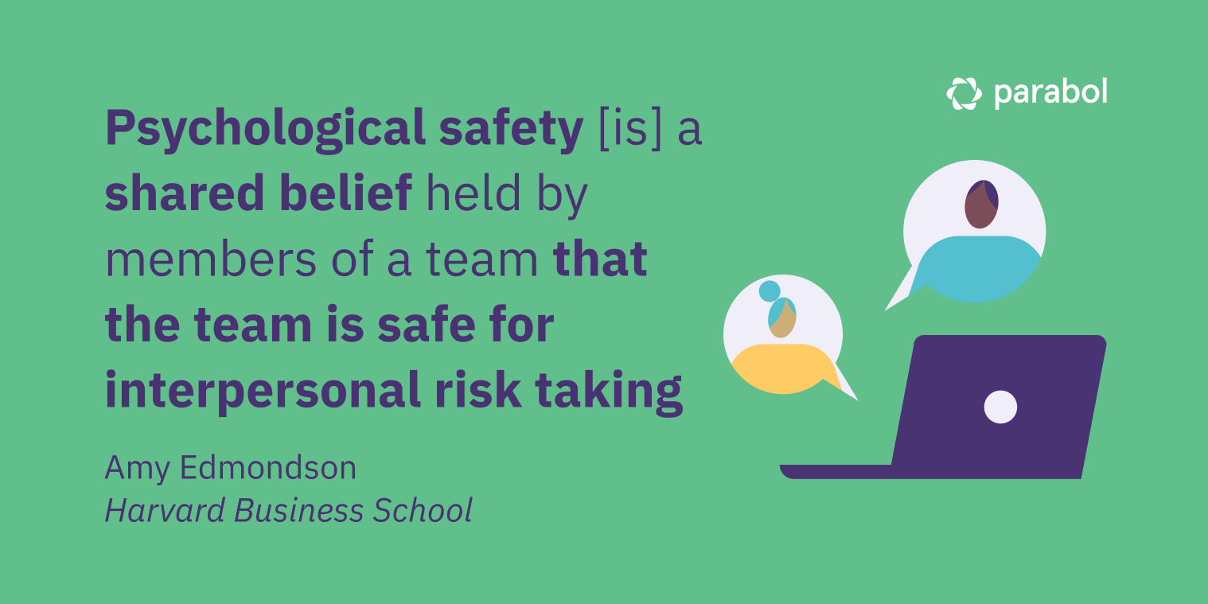
Creating psychological safety in diverse teams
Notes:
Steps:
1.Show : Source: https://www.ted.com/talks/erica_joy_baker_how_do_we_bridge_the_anxiety_gap_at_work.
Or ask students to watch before class
2. Discussion question : Why is psychological safety particularly important for diverse teams/teams with minorities like the “Non-Native Speakers”? What can you do to increase the psychological safety in your team?

Slide 12
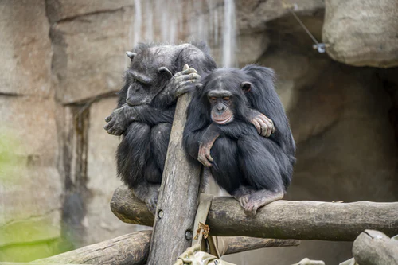
Break
Photo by Sepp Rutz on Unsplash
Notes:
Take a break to let everything sink in.

Slide 13
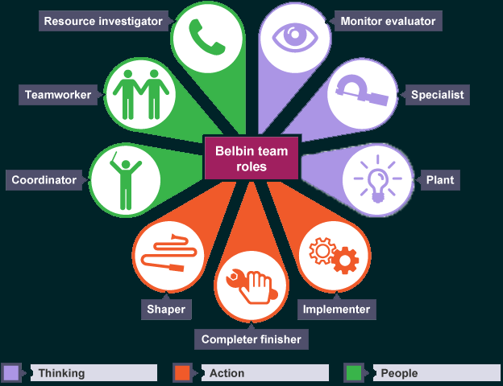
Which roles in a group do you feel suit you best?
Notes:
Show : https://www.youtube.com/watch?v=7LunroajlLE
Make sure to emphasize that a role does not define you as a group member, one group member can fulfill multiple roles and will fulfill different roles at different times in the project.

Slide 14
Self-reflection
Which roles do you feel suit you? Which descriptions best reflect your past team behavior and your unique talents?
Would you like to try other roles in the team? Move out of your comfort zone? What skills do you need to develop to do this?
5 mins
Individual / class discussion
Notes:
Provide students with the handout to read : https://www.belbin.com/media/2307/belbin-team-role-summary-descriptions.pdf
Give them time to read the handout and reflect using the questions on the slide.
Give some time for students to share: did anyone discover something new about themselves?
Discuss the equal value and importance of all team roles. When exploring other team roles ..check if the students are critical and reflective about social (gender) norms/value of one kind of role over the other.

Slide 15
Communication: Discussion
Watch this video
Why did this happen?
What could they have done differently?
Notes:
The screen icon is hyperlinked – but perhaps have it open at the start of class.
Video Link: https://www.youtube.com/watch?v=i9efIq1TxzE&ab_channel=MuthuiMkenya
It is a short, funny video of a trust building exercise that goes quite wrong.
Hopefully, the students will realize that it was because of poor communication on behalf of the man leading the session.
Hopefully, they can come up with suggestions for good communication to avoid such a situation.
Suggestions: be specific and as explicit as possible about expectations/directions especially in culturally diverse groups
The slide is animated so the bits should show in 3 stages.

Slide 16
Effective communicators
Explain their own ideas succinctly:
First think/write then speak
Come prepared to meetings
Express their needs, feelings, in a non-threatening way:
Don’t blame or judge. Speak using I statements.
Listen actively to others:
Ask questions to clarify others’ ideas
Take pre-emptive actions to prevent tension:
Be explicit about expectations from the start!
Reflect on their own work and encourage others to do the same
Notes:
These points are taken from https://uwaterloo.ca/centre-for-teaching-excellence/teaching-resources/teaching-tips/tips-students/being-part-team/teamwork-skills-being-effective-group-member
They have been re-worded from the communications section:
The best way to teach this is to tell a story about your own teamwork experiences/challenges . By personalizing the students will remember the tips better .
“To function successfully in a small group, students need to be able to communicate clearly on intellectual and emotional levels. Effective communicators:
can explain their own ideas succinctly
express their feelings in an open but non-threatening way
listen carefully to others
ask questions to clarify others’ ideas and emotions
will initiate conversations about group climate or process if they sense tensions brewing
Reflect on their own work and encourage others to do the same
Regular open communication, in which group members share their thoughts, ideas, and feelings, is a must for successful group work. Unspoken assumptions and issues can be very destructive to productive group functioning. When students are willing to communicate openly with one another, a healthy climate will emerge, and an effective process can be followed.”
See Inclusive Education Knowledge Platform Pillar Connective Communication for more information: https://www.eur.nl/en/impactatthecore/connective-communication
Icon Attribution:
Icon made by Freepik on www.flaticon.com

Slide 17
Game of Telephone
10 m
10-12 students sitting in a circle
One student is given a piece of paper with a silly statement on it. This student whispers this statement in the ear of the student sitting to their left. This is repeated till all the students have been whispered to.
Did the last student hear the same thing that was written on the paper?
10-15mins
Notes:
This exercise is corona rules dependent and may not fit into the time allocated for a seminar group. It can be fun but it is not necessary
Consider the cultural context and language in the statement/discussion . Example statements :
Two tiny toads ate fat flying flies.
The funny bunny hid the colored candy in the colored can.
The queen sat on her throne and ate thorny kumquats.
Many maids mop motels.
Dogs dig holes for big bones.
A bunch of yellow bananas launched on a blue boat.
Twelve tumbling purple people pulled turnips.
(found on: https://icebreakerideas.com/telephone-game/)
Debriefing : Listening skills/why listening is so hard

Slide 18
Effective communicators’ Best Practice
Active Listening:
Clarify what you think you heard by repeating it back to the speaker. Don’t stop doing this till the speaker is satisfied that you understand.
Notes:
This is just a bit of advice; you can maybe give an example of how you can use this in your own communication.

Slide 19
Creating a team charter
Notes:
STEPS.
1. Explain to students : A team charter is a type of contract outlining the way of working and governance of the team processes. There are many different formats for a team charter. This team charter will cover the following sections:
-Communication & way of working
-Roles
-What if
2. Creating the team charter will involve two distinct phases: an individual reflection phase and a team-working phase. During the individual reflection phase each team member will take some time to consider their unique profile and what they can bring to the team.
3. The second phase will involve team discussion to fill out the sections in the template. Hand out or send template digitally to the teams
4. Set and share a deadline for handing in the team charter assignment. Tutors and tutor coordinators should create a grading rubric for this assignment. We suggest it be at least 10% of the final group project grade.

Slide 20
Teamwork is hard but it gets easier when you know yourself, communicate openly; and actively listen to and respect your teammates.
Notes:
Finish the session by thanking the students for their time and adding any necessary closing remarks.
Remain available for questions, or conduct a Q&A based on the feeling in the room.

