Slide 1
Beyond Hardin, and even Ostrom. Commons and The dynamics of European institutions for collective action over the past 1000 years…
Prof. Dr. Tine De Moor, Utrecht university
The International Association for the Study of the Commons (IASC)

Slide 2
commons?
Peer-to-peer-economy?
All the resources we own collectively?
Common Pool Resources?
All that we share?
Sharing economy?
Citizens’ initiatives?
Common Property Regimes?
Common Pool Institutions?
Collaborative consumption and production?
Notes:
First of all: welcome on behalve of IASC, probably the only academic organisation in the world that also has practitioners among its members and is concerned about and directed towards bringing scientific results into practice. I’ll tell you more about the IASC at the end of my talk, but let’s first talk about what the IASC really is about. Commons!
The iasc was set-up 25 years ago in a time when people only knew about commons because they had read hardin’s tragedy of the commons and some might have read lin ostrom’s governng the commons, but let’s be fair. Not that many people knew abpout the commons. It’s not until say the last 10 years, and in particular since 2009, commons received more attention.
Plenty of frustration
Interestingly: the first URBAN commons conference

Slide 3
Why such a difficult concept?
Very long-term use -> long history of potential “misuse”
Hardin: application of concept of commons on global resources with different features than “original” commons
Conceptual “overstretch” of term commons: features of open access resources without controls imposed on access and use
Local example for problems on global scale
Linkage of wrong features (e.g. lack of communication means)
In an era of emerging awareness about environmental problems
Negative connotation to collective use not new but can now be contrasted to “consolidated” private an state solutions
Ostrom: Return to original features of concept but broadening to other types of resources (a.o. Irrigation commons; late 1990s: virtual resources)
Today: applied to many different resources and services AND types of collectivities

Slide 4
But is the focus on the resources legitimate?
Commons - i.e., governance regimes of natural or man-made resources shared among different members of a group according to collectively set agreements
-> represent a particularly interesting and well-studied case of social dilemmas
-> since Hardin (1968): commons have been studied as iconic situations where individual interests are at odds with collective ones.
-> Later work (Ostrom 1990): INSTITUTIONS are key to avoid unnecessary “tragedies” (Ostrom 1990), and can ensure that collective arrangement “endure” or are “robust”/”resilient”
-> inherent in the study of commons since: the expectation of long-term perspective; long-enduringness = success
Thus: the capacity to overcome a social dilemma once is in fact not what makes it succesful
-> longitudinal study is essential, history is essential!

Slide 5
Why does the current “paradigm shift” seem revolutionary?
We have forgotten about the collectivity as a ‘valid’ organisational unit
18th century:
-The “individual” becomes the central unit in society (Enlightenment)
-rationalisation of agriculture through Physiocratie
19th century: Nation State:
-introduction of code civil as legal basis for individual rights
-organisation of society becomes centralised, including legal and economic basis
-> 1750s-1850s: implementation of regional and national legislations across Europe to abolish/split up/sell the commons
e.g. Belgium, 1847: “Loi sur le défrichement” = in fact a privatisation law
-> by middle 19th century: centralised dissolution of common land all over Western Europe

Slide 6
Once upon a time in Europe…
« Land that is managed and used in common »
Different terms:
Dutch: gemene grond, heirnis, meent, markegenootschap…
German: Markgenossenschaften, Allemende,…
In Europe: originated mainly in 12th-13th century, during/after Great Reclamations (10-12th century)
Mixed agricultural system demanded balance between arable and pasture land
In reaction to pressure on mixed-agricultural system as reaction to demographic pressure
Main aim of institutionalisation: achieving balance in exploitation level
Often as land conflict settlements between lords and villagers
Divided rights on same piece of land
Beforehand: common use of land within family-clan-tribe

Slide 7
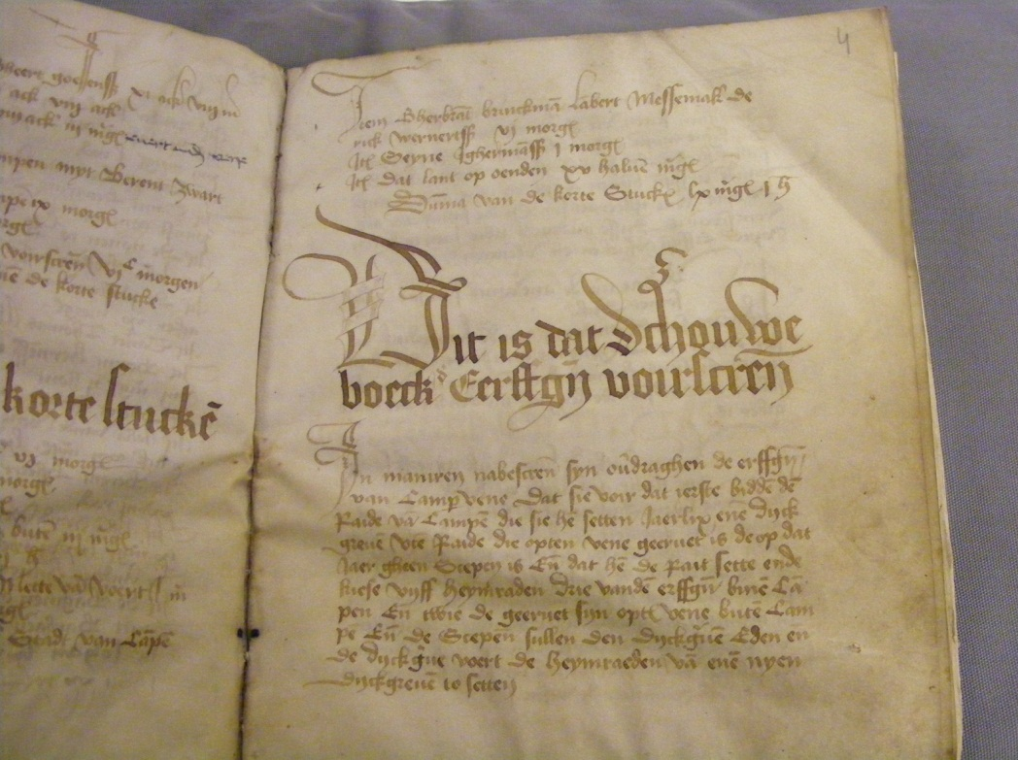
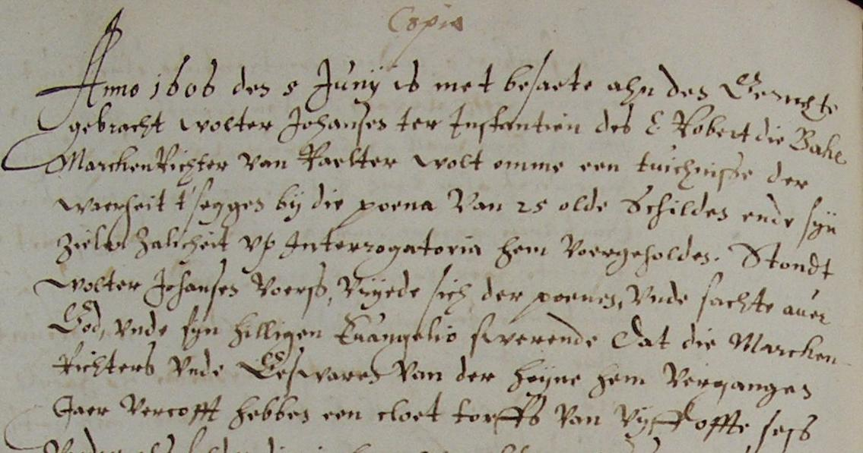
Marke Raalterwoold (Overrijsel, Netherlands), (before) 1445 – 1859
Markenboek 1615 (incl. copies of earlier regulations) - 1859

Slide 8
Gemene and Loweiden (Near Bruges, Belgium): 14th century-today
Common rights: mainly pastureland
Access for descendants from specific families only
Notes:
I studied this long-term interaction on the commons between users, resource and institution, by concentrating on a common near Bruges in Flanders, called the Gemene and Loweiden. Access to this common was hereditary and allowed the commoners to use the meadow for their cattle and gave them some other rights on for example timber. The commoners managed the resources autonomously, except for a period of 20 years, 1862-1882. Due to a conflict with the local government that tried to get its hands on the land, the court had decided to let it be managed by an independent party, as long as the court case ran.
Due tot the fact that the common is still in the hands of the commoners or the so-called aanborgers today, a large number of archival documents in excellent state have been preserved. For my research I could use resolution books, name lists of commoners, the bookkeeping of the common. Especially this last source was particularly helpful and nearly continuous for the 18th and 19th centuries.

Slide 9
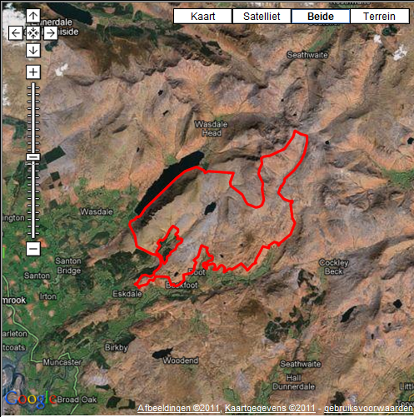
Eskdale commons (Cumbria, England) Middle Ages - c. 1859
Common rights: pasture, peat and turves, bracken
See also: http://www.collective-action.info/_CAS_COM_ENG_EskdaleCommonManorCourt
Experts: E. Straughton and A. Winchester

Slide 10
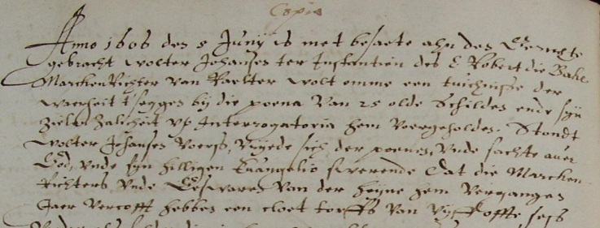
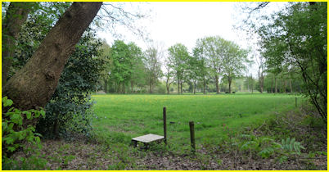
Gemene gronden/heirnis/ meenten/ Markegenootschappen

Slide 11
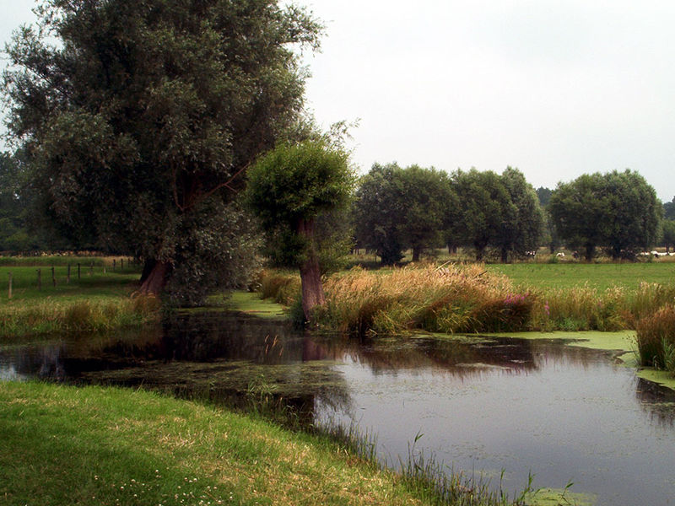
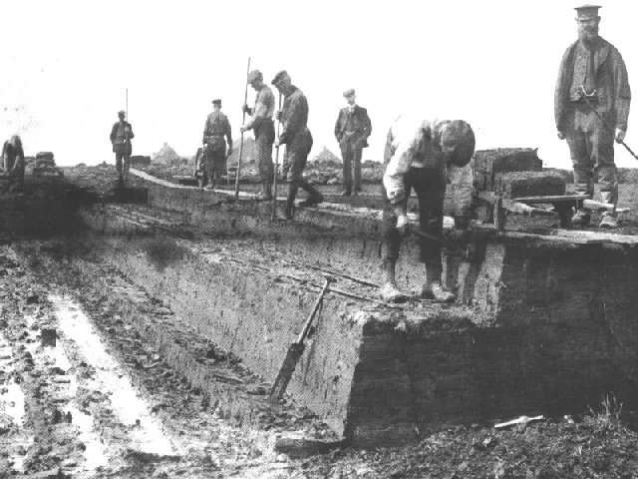
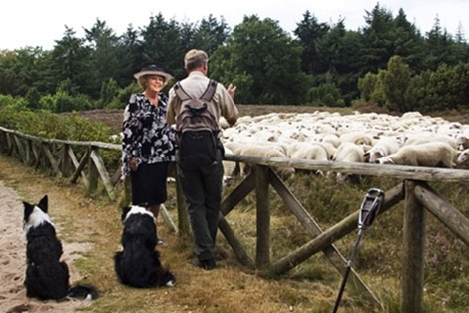
USE of commons
Digging peat
Maintaining infrastructiure
Herding animals
Notes:
Kort ingaan op omgeving:
Zandgronden, rivierafzettingen
Veenvorming > turfwinning > depletable sources
Relatief weinig grootschalige landbouw, relatief veel onontgonnen gebied tot 19e E

Slide 12
Examples UK
Common | Surviving regulations | Date of dissolution
Alston Moor | c.1500 (copied 1597; updated 1692 | 1820
Braithwaite & Coledale | 1678-1816 | Still common land
Eskdale | 1587; 1659-1841 | Still common land
Hutton in the Forest | 1637, additions 1650 | 1819
Millom | 1514-1670 | 1824 (partial)
Netherwasdale | 1678-1857 | Still common land
Thornthwaite | 1612-1778 | Still common land
Watermillock | 1610-1710 | 1835

Slide 13
Tools used to facilitate the historical commons
Right to vote in meetings (linked to household)
Obligation to attend meetings
Election of representatives
Rotation of responsibilities (incl. the annoying ones)
Intensive social control and sanctions for malefactors
Liability of those who shirk responsibility
_> ENFORCED VIA WRITTEN REGULATION

Slide 14
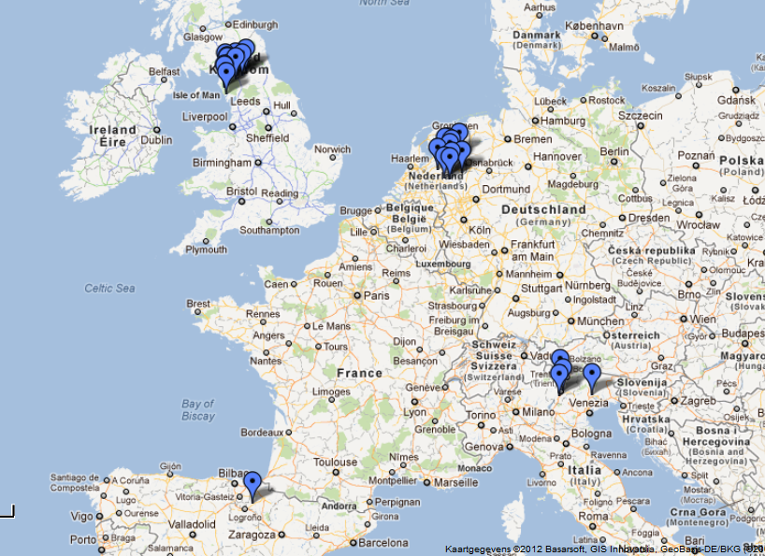
International comparison of Commons’ regulation
At the moment:
9 Dutch cases
23 Italian cases
10 English cases
10 Spanish case
 all pasture commons
 frequent changes in regulation in between 1300 and 1900

Slide 15
Dutch cases
Name | 1275 | 1300 | 1325 | 1350 | 1375 | 1400 | 1425 | 1450 | 1475 | 1500 | 1525 | 1550 | 1575 | 1600 | 1625 | 1650 | 1675 | 1700 | 1725 | 1750 | 1775 | 1800 | 1825 | 1850
Coevorden |  |  |  |  |  |  |  |  |  |  |  | 1545 | 1552 | 1579, 1586 | 1617 | 1647 |  |  |  |  | 1773 | 1778
Marke Rozengaarde |  |  |  |  |  |  |  |  |  | 1480, 1481 |  | 1543, 1548, 1549 | 1556, 1557, 1558, 1560, 1561, 1564, 1565, 1566, 1571, 1572 |  | 1601 |  |  | 1698 | 1700 |  | 1759, 1760, 1762, 1763, 1764, 1767
Marke Raalterwoold |  |  |  |  |  |  |  | 1445 |  |  |  | 1541 | 1560 |  | 1604, 1605, 1608, 1609, 1610, 1611, 1614, 1615, 1616, 1618, 1620, 1623, | 1625, 1627, 1628, 1631, 1633, 1635, 1636, 1639, 1640, 1642, 1643, 1644, 1645, 1647, 1649 | 1650, 1652, 1654, 1655, 1657, 1660, 1662, 1664, 1670, | 1676, 1681, 1686, 1696 | 1704, 1705, 1707, 1710, 1713, 1714, 1719 | 1725, 1731, 1738 | 1755, 1758, 1760, 1761, 1763, 1764, 1767, 1770 | 1775, 1789, 1791, 1793, 1794, 1797, 1798 | 1800, 1802, 1804, 1805, 1806, 1806, 1808, 1809, 1810, 1811, 1812, 1813, 1814, 1815, 1816, 1819, 1824 | 1825, 1827, 1829, 1831, 1832, 1834, 1835, 1839, 1840, 1841, 1842, 1843
Marke Exel |  |  |  |  |  |  |  |  |  |  |  |  |  |  | 1616, 1618 | 1628, 1634, 1636, 1642, 1643, 1645, 1647 | 1650, 1656, 1659, 1660, 1661, 1662, 1663, 1667, 1671 | 1677, 1678, 1679, 1681, 1684, 1686, 1691, 1695, 1697 | 1700, 1703, 1704, 1706, 1707, 1714 | 1734, 1737, 1740, 1741, 1745, 1747, 1749 | 1751, 1752, 1768, 1772 |  | 1810, 1811 | 1829, 1835, 1836, 1837
Dunsborg Hattemer mark |  |  |  |  |  |  |  |  |  |  |  |  | 1553, 1558 | 1576, 1577 | 1608, 1609, 1612, 1616, 1617, 1619, 1621, 1622 | 1637, 1640, 1642, 1643 |  | 1677, 1683, 1684, 1686, 1687, 1688, 1690, 1691, 1692, 1694, 1695, 1696, 1697, 1699 | 1701, 1703, 1704, 1708, 1711, 1719, 1721, 1722, 1723 | 1726, 1727, 1728, 1729, 1731, 1732, 1735, 1736, 1737, 1739, 1741, 1745, 1747, 1748 | 1752, 1753, 1754, 1766, 1767, 1769, 1770, 1772 | 1775, 1785, 1789, 1792 | 1800, 1801
Marke Berkum |  | 1300 |  |  |  |  |  |  |  | 1492 |  |  | 1571 |  | 1602, 1603, 1604, 1606, 1608, 1609, 1610, 1611 | 1631, 1632, 1647, 1649 | 1651, 1656 | 1692 |  | 1725 | 1763, 1766, 1772 | 1777 |  | 1819, 1830
Marke Bestmen |  |  |  |  |  |  |  |  | 1458 |  |  | 1529, 1537 |  |  |  | 1634, 1649 | 1656, 1661, 1662, 1670 | 1681, 1687 |  | 1725, 1747 | 1770, 1771 | 1783, 1786, 1790, 1793, 1797 | 1804, 1808, 1809 | 1827, 1842
Marke Het Gooi |  |  |  |  |  |  | 1404 | 1442 | 1455 |  |  |  | 1568 |  |  |  |  |  |  | 1741 | 1762 | 1783 | 1804
Geesteren, Mander en Vasse |  |  |  |  |  |  |  |  |  | 1498 | 1509 | 1533, 1546, 1547, 1548, 1549 | 1551, 1552, 1553, 1554, 1555, 1556, 1557, 1559, 1560, 1561, 1563, 1564, 1565, 1570, 1571, 1572, 1574 | 1576, 1582 | 1600, 1603, 1605, 1610, 1611, 1613, 1615, 1618, [...] | [...], 1631, 1635, 1643, 1644, 1647, [...] | [...], 1669 | 1676, 1677, 1678, 1679, 1682, 1683, 1684, 1690, 1691, 1695, 1696 | 1701, 1708, 1711, 1712, 1713, 1723 | 1733, 1740, 1741, 1742, 1744, 1747, 1749 | 1753, 1754, 1758, 1760, 1761, 1767, 1769, 1770, 1771, 1772

Slide 16
Dealing with the market: Rules against over-use due to commercialisation
Limitation of the number of cattle in relation to the capacity of resource:
Cattle had to be in possession of user during previous winter
Grazing of cattle bought before grazing period was restricted
Grazing cattle of non-entitled users was forbidden
Linkage of the number of cattle to surface of arable in private property
Selling products from the common was forbidden (outside the village)
Use of common limited to own needs

Slide 17
Historical Examples of limitations of use
“Nobody shall sell or give away peat to anyone living outside the village” (Arendonk, Flanders, 15th century)
“The right to pasture cannot be sold or leased, nor can the milk coming from the cows on the common be sold” (Hierinis, Flanders, 1705)
“no member is to take more peat than he can transport on his own wagon and in his own house wants to burn” (Dunsborger Hattemer mark, The Netherlands, 1558)
“those with user-rights are not to sell peat, but only cut it for personal use” (Marke Bestmen, The Netherlands, 1770)
“Nobody can sell his peat (from the common)” (Maleveld, Flanders, 1718)
“living within the mark be allowed to collect sods in order to sell those sods to someone outside of the mark” (Mark Raalterwoold, The Netherlands, 1541)
-> each of the rules was accompanied with a serious fine
-> The market: threat and stimulus for institutionalisation at the same time
SEE OUR “COMMON RULES”-project at http://www.collective-action.info/_PRO_Main

Slide 18
Example analysis of sanctioning: Starting point
Making rules and sanctions is a costly affair
 making rules requires attendance to meetings to confirm the rules
 monitoring demands energy and time
 applying sanctions is costly
 We are trying to identify and compare EFFORT in rule-making and making sanctions (within and in between cases)

Slide 19
Graduated Sanctioning is exceptional!
Raalterwoold, 1608: graduated sanctioning
Transcription | Interpretation
die Vloetgravens, die niet nae behoer gewidet worden, muchten up olden gewoenten gemaecket worden, unde geschouwet neffens twie mede-erffgenhamen Ordineert dat die selve nha older gewoonte gescraet unde gemaecket sult worden, nemende die ierste reijse tho brocke 7 stuiver, die andere maell 14 stuiver, ten derdemaell bij die verpeninge. | Obligation to restore the small leat to the state it used to be in, this leat not having been pastured appropriately, and to be inspected with the presence of two fellow-inheritants. Failing to do so will be fined at 7 stuivers for the first offence, 14 stuivers for the second offence and a fine yet to be determined for the third offence.
Exel 1634, distribution of sanctions among diff. parties
Transcription | Interpretation
Niemandt sal meugen enige plaggen ende schadden uyt dese marckte voeren bij poene van vijff olde schilden tot behoeff des schutters, erfgenaemen ende markenrichter ter gelijcker quoten. | None may take any peat out of the [marken] or will be fined 5 old shield, to be shared in equal parts by the [schutters], inheritants and the chairman of the maalschap.
Het Gooi, 1741, confiscation of cattle when using other person’s cattle
Transcription | Interpretation
Indien een beest t'zij paerd of koey, van een ander daar den schaerder niet suyver geheel en al, eenvoudig en opregt, den eygenaer van is, mogt geschaard worden, soo sal niet alleen het selve beest verbeurt zijn, maar ook de schaarder die de veldslag heef | If an animal is placed on the common by a person who is not the owner, the animal will be confiscated and the person who has committed the offence will be excluded from the common for two years.
Comun Comunale, 1544, obligation to sanction free-riding non-members
Transcription | Interpretation
7. Item statuisseno et ordenano che se alcun forester come di sopra el qual non sarà fatto homo del ditto comun, et lui contravegnira et farà contro li ordeni infrascritti, alhora tutti li homeni delli ditti comuni siano obligati insieme aiutarse e spender cossì in lite come fuor de lite contro tal forester. | Also it is decided and ordered that if a foreigner is not made member of that community, and he will contravene and infringe the mentioned orders and rules, then all the men of all the communities shall be obligated and bound to help each other and to start a litigation against that foreigner.

Slide 20
Dealing with depletable resources
‘In regard to the digging of sods by commoner Hooffslach, the sworn members as well as the neighbours have complained that this damages the common, and hence the commoners present have ordered that Hooffslach will refrain from digging sods from the brook, until further notification by the chairman and the assemblee of commoners. From today on, he will not be allowed to transport any sods to his house, located in the brook, unless Hooffslach is able to show authorisation.’
Marke of Markelo (1615)

Slide 21
DEALING WITH DEPLETION: EVOLUTION REGULATION AND SANCTIONING (EXEL, PEAT)

Slide 22
Conclusions
Remarkable overall similarities in case studies in terms of division of “effort” to make rules and sanctions
Commons that had a longer life span
made less regulations with sanctions attached
Made more frequent changes and less changes per meeting
Sanctioning was used with care, see e.g. use of graduated sanctions
Several results (difference in effort to sanction management; need to repeat rules) indicate that the management of the institution mattered a great deal for the longevity of the institution  a good design –and implementation?- of the management rules was the decisive factor
Considering the above: the level of participation was probably what made the regulation so effective
Investment in internalization of rules is more important for longevity than actual rule-making?

Slide 23
Running an institution and keep it going: that’s hard work!

Slide 24
Which motivations did and do commoners have in common?
Economies of scale
Collective bargaining position towards authorities
Sharing risks and resources
Lower search and information costs
internal agreement on the price of the goods
collective meetings with compulsory attendance
Reduced transaction costs due to group-based access regulation
Keeping close to local economies, shorten the chain
BUT WHY ?
Reaction to periods of increased commercialisation, privatisation and subsequent market failure
-> also visible in the emergence of other types of INSTITUTIONS FOR COLLECTIVE ACTION

Slide 25
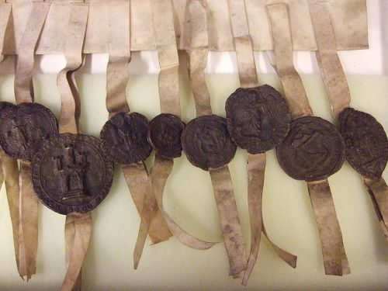
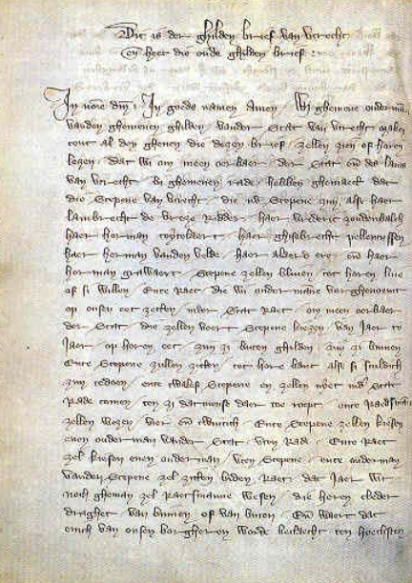
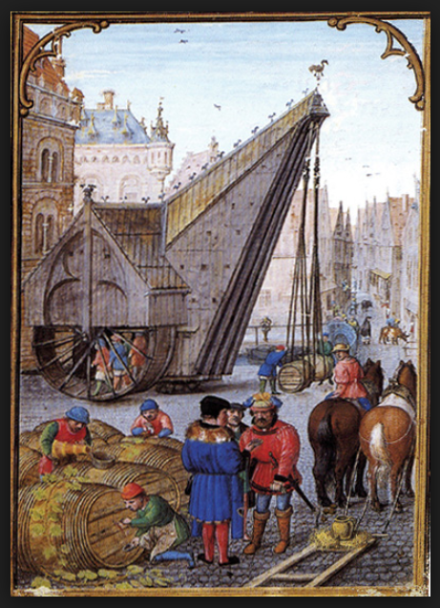
merchant- & craft guilds

Slide 26
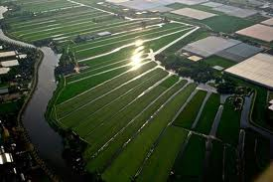
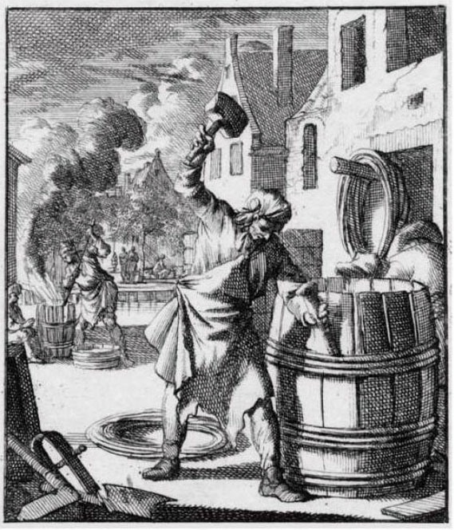
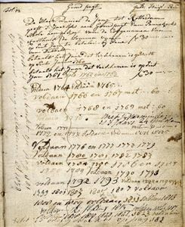
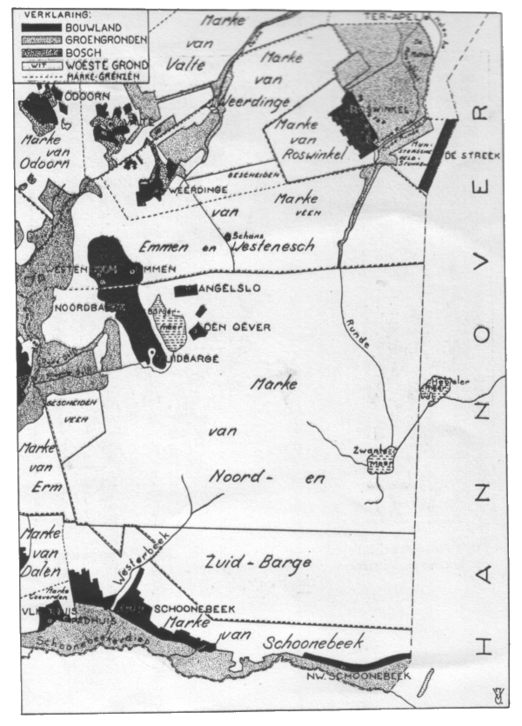
Andere vormen van institutions voor collectieve actie in Vroegmodern europa
Veenraadschappen
Waterschappen
Irrigatiegemeenschapen
Begijnhoven
Vanaf 19de eeuw: coöperaties!
Meer voorbeelden examples: See “case studies” at www.collective-action.info

Slide 27
First wave: Commons, guilds, waterboards...: 1000-1600 (example netherlands)
Liberalization
Formation of nation-states
log

Slide 28
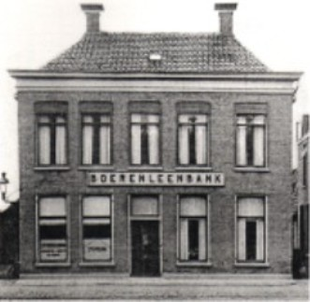
Second wave: Cooperatives, associations, labour unions, 1880-1920
RURAL!!

Slide 29
EvolutiOn of the number of new cooperatives per sector 1990-2012 (netherlands)

Slide 30
Differences between ICAs in the past and today
Goals have been “split-up”:
Historical:
Social and economic benefits/purposes brought together into one collective
Consumption and production together
Now: participating in several different collectivities is essential to provide for all everyday needs
-> Disadvantage:
Reduces the opportunities for using reciprocal behaviour as a complementary incentive
To provide for all needs, one needs to be a member of several different collectivities
Memberships of individual members last considerably shorter
Life span of modern institutions is remarkably shorter than life span of institutions that emerged in the first wave
-> less resilient institutions?

Slide 31
1000 YEARS OF THE Homo cooperans?
3 large waves of new institutions for collective action
Always in reaction to accelerated developments within the free market system and privatization
Not a reaction to current crisis:
Wave started already before the crisis started
Wave can be identified in many various sectors
Is not related to ‘crisis-susceptability’ of region
Role of citizens?
-> Requires improved balance between various governance models: market, state, citizens
-> Requires self-reflection within the new movement
-> Requires increased institutional diversity

Slide 32
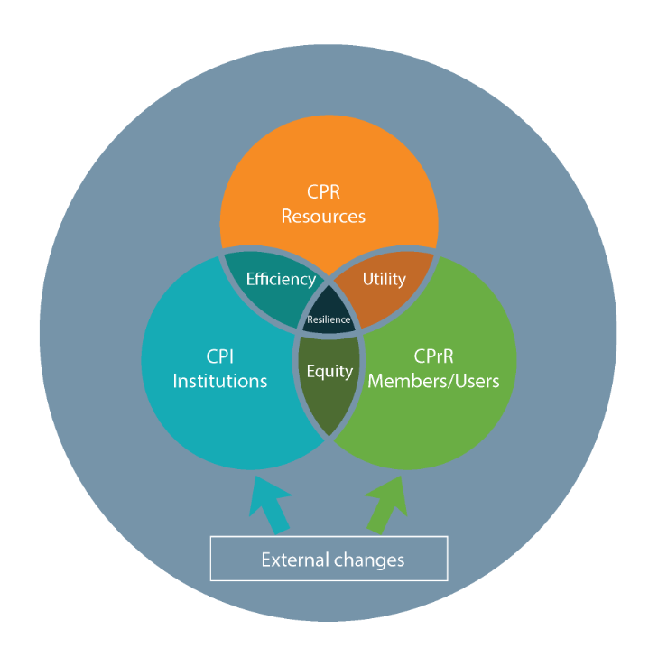
Threedimensional approach to ICAs
De Moor T., 2015. “The Dilemma of the Commoners”, CUP.
Common pool RESOURCES
COMMON PROPERTY REGIME (entiteld USERS)
Common Pool INSTITUTION

Slide 33
Threedimensional approach to ICAs
RESOURCES:
-use has effect on stock
-use can be phyiscally delimited
USERS: prosumers
Builds on reciprocity through participation of a well-defined group of people
INSTITUTIONS:
based on
Self-regulation
Self-sanctioning
Self-governance

Slide 34
Notes:
Given the current activities on commons in the western world, we have chosen the title practicising the commons. We’ve got lots of interesting meetings coming up but for now, this is exactly what I would like you all to do over the next two days: practice the commons!

Slide 35
