Slide 1
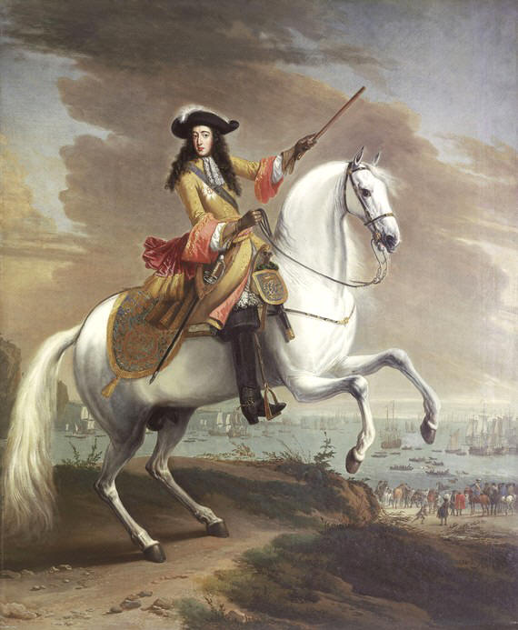
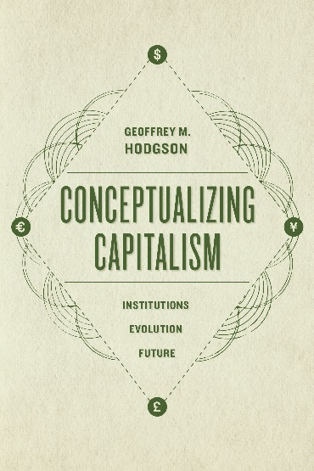
1688 and All That: Property Rights, the Glorious Revolution and the Rise of British Capitalism
Geoffrey M. Hodgson
www.geoffrey-hodgson.info
g.m.hodgson@herts.ac.uk
1. 1688, the balance of power and property rights
2. Bad timing: the evolution of property rights in England
3. The financial and administrative revolutions
4. Conclusion
/ 25

Slide 2
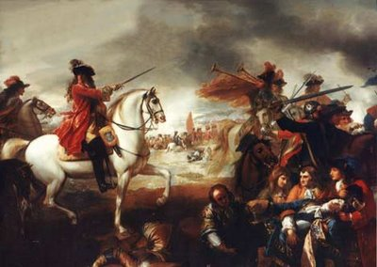
1688 and All That
1. 1688, the balance of power and property rights
Dutch invasion led by William of Orange in 1688.
In1689 Parliament made William and his wife Mary joint monarchs:
“Declaration of Right”
Was this a key event in the rise of British capitalism?
/ 25

Slide 3
1688 and All That
1. 1688, the balance of power and property rights
Douglass North & Barry Weingast (1989):
The development of Britain’s modern economy depended on “secure property rights” and the “elimination of confiscatory government” …
… These were alleged results of Glorious Revolution of 1688.
/ 25

Slide 4
1688 and All That
1. 1688, the balance of power and property rights
Daron Acemoglu, Simon Johnson and James Robinson (2005): in the Middle Ages in England there was a “lack of property rights for landowners, merchants and proto-industrialists”
… their “development” first occurred in the late 1600s, when “strengthening the property rights of both land and capital owners … spurred a process of financial and commercial expansion.”
The 1689 settlement limited the power of the monarch and facilitated “the development of property rights”.
/ 25

Slide 5
1688 and All That
1. 1688, the balance of power and property rights
But many historians have stressed the “conservative” nature of the constitutional settlement of 1689. …
It was aimed at the restoration of established rights: it was “defensive” rather than innovative (Western 1972, Scott 1991, Jones 1992, Morrill 1992, Trevor-Roper 1992, Nenner 1997, Pincus 2009, Ogilvie and Carus 2014).
Historians pointed out that property rights were already relatively secure before 1688 – by 1600 or even earlier (Clark 1996, 2007, Sussman and Yafeh 2006, Ogilvie and Carus 2014).
/ 25

Slide 6
1688 and All That
1. 1688, the balance of power and property rights
Julian Hoppit (2011): property was no more secure after the Glorious Revolution: the very fact that Parliament met more often posed greater legislative risks to property
(e.g. 1833 abolition of slavery).
Gregory Clark (1996): “Institutionalists were stretching a point when forging the link between the institutional changes of 1688 and the Industrial Revolution beginning in 1760.”
/ 25

Slide 7
1688 and All That
2. Bad timing: the evolution of property rights in England
In the twelfth and thirteenth centuries, new legal systems were developed in England under the influence of the new canon law of the church, and the discovery of Justinian Roman law (Berman 1983, 2003).
Property rights in England were relatively secure for the wealthy minority by the thirteenth century.
The problem was the feudal nature of those property rights.
/ 25

Slide 8
1688 and All That
2. Bad timing: the evolution of property rights in England
Well-defined rights often carried feudal obligations such as entails … ensuring that a landed estate passed from one generation to another through the eldest son.
But even when the courts limited the scope of entails in 1614, these were replaced by voluntary and widespread strict settlements that had similar effects, and prevailed until the nineteenth century.
/ 25

Slide 9
1688 and All That
2. Bad timing: the evolution of property rights in England
Entails and strict settlements “restricted the uses to which land could be put. … Holders could seldom sell, swap, or mortgage property under their control” (Bogart and Richardson 2011).
Such land could not be used as collateral.
Also common land, for the shared use of villagers: In 1700 about 26% of arable land in England was held as commons.
This too could not be used as collateral.
/ 25

Slide 10
1688 and All That
2. Bad timing: the evolution of property rights in England
Entails and strict settlements were defended by strong and enduring vested interests.
The potential role of property as collateral is neglected in much of “the economics of property rights” (Alchian 1965, Barzel 1989) …
… this often focuses on the matter of de facto control more than on the importance of de jure legal title (Cole and Grossman 2002, Hodgson JOIE 2015, Hodgson Conceptualizing Capitalism).
/ 25

Slide 11
1688 and All That
2. Bad timing: the evolution of property rights in England
Parliamentary Acts Reorganizing Landed Property Rights, 1700-1830.
Five-year moving averages, in a vertically cumulative presentation, using annual data from Bogart and Richardson (2011).
/ 25

Slide 12
1688 and All That
3. The Financial and Administrative Revolutions
The 1688 invasion led to an influx of Dutch merchants and financiers (Jardine 2008).
They brought knowledge of Dutch financial institutions and helped establish London as the world’s leading financial centre (Dickson 1967).
Stephen Epstein (2000) stressed England’s “belated catch up” with continental Europe’s most developed financial systems.
What else prompted the financial & administrative revolutions?
/ 25

Slide 13
1688 and All That
3. The Financial and Administrative Revolutions
Because of new international alliances and enemies, Britain was plunged into a long period of war, requiring major reform of its fiscal and administrative arrangements.
The Nine Years’ War (1688-97)
The War of Spanish Succession (1701-13)
The Jacobite Rebellions of 1715 and 1745.
The War of the Quadruple Alliance (1718-1720)
The Anglo-Spanish War (1727-1729)
The War of the Austrian Succession (1740-1748)
The global Seven Years’ War (1756-1763)
War or rebellion: in 47 of the 76 years from 1688 to 1763.
/ 25

Slide 14
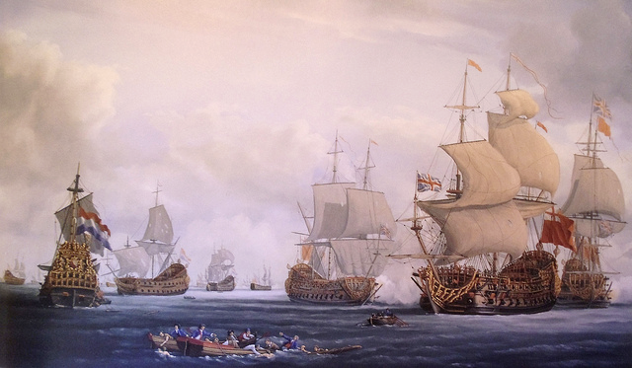
1688 and All That
Battle of Beachy Head 1690
/ 25

Slide 15
1688 and All That
Seven Years’ War 1756-63
/ 25

Slide 16
1688 and All That
3. The Financial and Administrative Revolutions
Contrary to the claim of North and Weingast (1989) that the political settlement of 1689 made government more stable and predictable ...
“Far from making government more predictable, the Revolution of 1688 instantiated one of the most intensely polarized and unstable periods in English and British history.” (Pincus and Robinson 2014)
The political settlement of 1689 between the King and Parliament secured the compliance of both in meeting the needs of war.
/ 25

Slide 17
1688 and All That
3. The Financial and Administrative Revolutions
The needs of war, and pressures of global and domestic commerce, were major forces behind the development and reform of financial institutions and state administration (O’Brien 2011).
Henry Roseveare (1991): accompanying the political and fiscal changes after 1688 there was “an administrative revolution … a striking growth in the power and effectiveness of the state which manifested itself not merely in war but in the subtler tasks of peace.”
/ 25

Slide 18
1688 and All That
3. The Financial and Administrative Revolutions
Full-Time Employees in the State Fiscal Bureaucracy, 1690-1783
Data from Brewer (1988).
/ 25

Slide 19
1688 and All That
3. The Financial and Administrative Revolutions
Total Tax Revenue as a Proportion of National Income, 1670-1810
Data from O’Brien (1988).
/ 25

Slide 20
1688 and All That
3. The Financial and Administrative Revolutions
Geoffrey Ingham (2008): “the capitalist monetary system developed from the integration of private networks of mercantile trade credit-money with public currency – that is, state money.”
Ingham (2008): “Capitalism is distinctive in that it contains a social mechanism by which privately contracted debtor-creditor relations … are routinely monetized.”
In the seventeenth century, commercial cases shifted from the law merchant courts to common law courts (Baker 1979, Berman 1983). But their “blundering attempts” (Beutel 1938) to deal with the negotiability of debt led businessmen to press Parliament for robust legislation.
/ 25

Slide 21
1688 and All That
3. The Financial and Administrative Revolutions
In 1704, during the reign of Queen Anne, Parliament passed “An Act for giving like Remedy upon Promissory Notes, as is now used upon Bills of Exchange, and for the better Payment of Inland Bills of Exchange.”
Another 1758 Act was required to consolidate negotiability (Beutel 1938, Lawrence 2002).
Once negotiability was established, the capitalist genie was out of the bottle. As Henry Dunning MacLeod (1872) wrote:
“If we were asked – Who made the discovery which has most deeply affected the fortunes of the human race? We think, after full consideration, we might safely answer – The man who first discovered that a Debt is a Saleable Commodity.”
/ 25

Slide 22
1688 and All That
3. The Financial and Administrative Revolutions
Growing opportunities for profit eroded longstanding, sentimental, family commitments to their estates.
This impelled the removal of entails and strict settlements, so that land could be used as collateral for loans.
Hence the major reforms to property rights in land followed rather than preceded the Financial Revolution.
/ 25

Slide 23
1688 and All That
4. Conclusion
Simplified causal chain:
Religious conflict and growing Stuart absolutism led to the popular success of the 1688 invasion
Britain plunged into a series of wars, until 1763.
De facto balance of power shifted slightly from sovereign to Parliament.
The 1689 parliamentary accord, and the needs of war, facilitated and impelled the Financial and Administrative Revolutions …
/ 25

Slide 24
1688 and All That
4. Conclusion
Simplified causal chain (concluded):
… Needs of war stimulated production, based on a new, financial system involving private institutions and the state.
Cumulative process of financialization, commercialization and industrial investment.
Especially after 1750: Reform of landed property rights: more land usable as collateral.
From about 1760: Industrial Revolution
/ 25

Slide 25
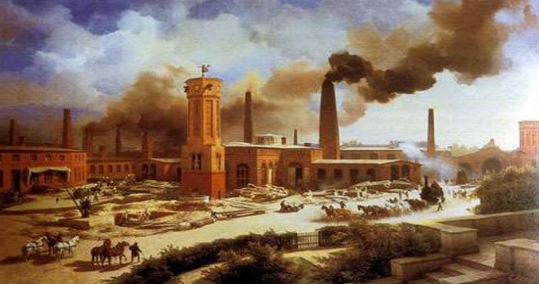
1688 and All That
/ 25

