Slide 1

Master Health Care Management Zorgmanagement
Dr. Isabelle Fabbricotti
Programme Director

Slide 2
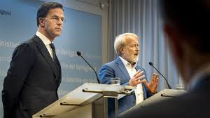


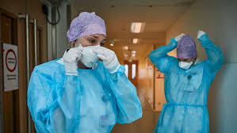
Why the Master Health Care management
Home care director: ‘They made a huge mistake in their estimation’.
NRC 12 april 2020
Decrease coronapatients in hospitals goes to slow, worries about restart usual care.
AD 29 april 2020
One million mouth-caps a week, that is still not enough.
Volkskrant 28 april 2020

Slide 3

Why the Master Health Care management
Challenges for healthcare managers
Patients and society want tailor-made quality of care
Health professionals need to be able to do their work and be satisfied
Organizations are accountability for their performance
Innovation in healthcare is necessary
Healthcare is business and politics

Slide 4

What is the Master Health Care Management
During the master you are trained to match knowledge from various academic fields (e.g. human resource management, quality & safety, financial management, logistics) with professional skills to deal with the complexities of contemporary healthcare problems and transitions. During this entire process, you never lose focus of patient demands and needs.
Do you aspire to be a critical thinking manager
in the healthcare sector?

Slide 5



Fulltime and parttime
Fulltime in one year (completely in English)
Parttime in two years (partly English, partly Dutch)
7 courses
1 elective
Thesis
Internship
Exchange
Management and personal skills

Slide 6
What are the courses?

Slide 7


Courses
Patient centered care delivery
How to make care patient centred
organise, manage, outcomes
Advanced research methods
Enhance quantitative and qualitative skills

Slide 8


Courses
Organisational behaviour
Human resource management
Behaviour and leadership in organisations and effects on
performance and health care delivery
Quality and Safety
Quality Management
Challenges in managing quality and safety

Slide 9
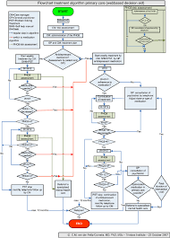

Courses
Health services operation management
Planning and control of processes
Logistics
Financial management
Managerial activities, decisions and management techniques to steer the organization from a
financial angle

Slide 10
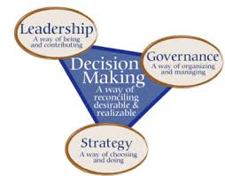
Courses
Governance and strategy
Changes in the policy environment affecting the ways they organize and manage daily care processes

Slide 11

Electives
Healthcare Procurement & Value Chain Management
Health Service Innovation
Healthcare Ethics
E-health/ big data
A course of your choice…
(to be accepted by the exam committee)

Slide 12
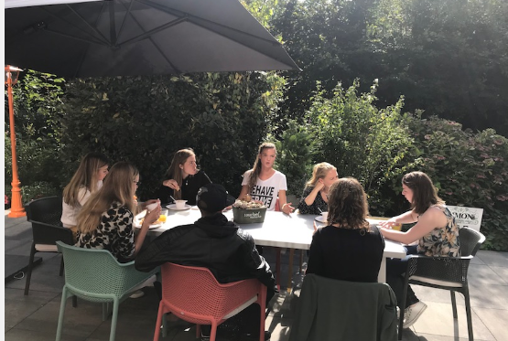
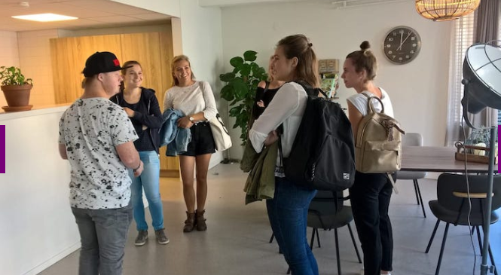
Management and Personal skills
Serious games
Dilemma game
1-day internship
Negotiating, communication, leadership style

Slide 13



International exchange
One to three courses
2 to 4 months
Thesis: country of own choice
Internship: country of own choice
Possibilities depend on timetables universities and Corona

Slide 14

Internship: what?
Working in a future job
Together with a supervising manager or senior policy worker
During 5/6 months: 2 to 3 days a week
No salary (sometimes 250 euro reimbursement): better not to have a salary
Instead of elective

Slide 15

Internship: why?
Get work experience and
experience in daily practice healthcare
Understand theoretical knowledge and models
Development academic, professional and personal skills
Better equipped for future job
Better equipped to succeed in the master
1 in 4 gets a job at organization internship

Slide 16
What does my agenda look like?

Slide 17
Curriculum full-time
Full-time
Blok | Course 1 | Course 2
1 | Patient Centered Care Delivery (5 EC) | Advanced Research Methods (5 EC)
2 | Quality and Safety (5 EC) | Organisational Behaviour (5 EC)
3 | Health Service Operations Management (5 EC) | Thesis Proposal (5 EC)
4 | Financial Management (5 EC) | Thesis (15 EC)
5 | Governance and Strategy (5 EC) | Thesis
6 | Elective/ Internship (5 EC) | Thesis

Slide 18
Timetable
Internship
At least 3 days a week
Tuesday: working groups
Thursday: working groups
Friday: plenary classes
Internship

Slide 19
Curriculum part-time
Part-time
Blok | Year 1 | Year 2
1 | Patient Centered Care Delivery (5 EC) | Advanced Research Methods (5 EC)
2 | Quality and Safety (5 EC) | Organisational Behaviour (5 EC)
3 | Health Service Operations Management (5 EC) | Thesis Proposal (5 EC)
4 | Financial Management (5 EC) | Thesis (15 EC)
5 | Governance and Strategy (5 EC) | Thesis
6 | Elective/ internship (5 EC) | Thesis

Slide 20
Timetable
1 day a week
Friday: plenary classes and working groups
Internship:
Monday through Thursday

Slide 21
What are the admission requirements?

Slide 22
Bachelor or master of science degree
Dutch university | NON-Dutch university
Direct access if: Bachelor related to relevant management and organisational sciences Bachelor in Medicine Premaster | Same criteria, but always evaluated by admission board
Other: at least one course on healthcare management or health organization
All applications will be
individually evaluated by the admission committee before admission is granted.

Slide 23

I cannot finish my prior education due to Corona… and what about Corona
Soft cut (15 May)
Master will be given
Online or on campus

Slide 24
Proficiency in mathematics
a VWO diploma with mathematics A, B, C or equivalent or
research methods in previous education, to be assessed by the Admission Board or
a VWO mathematics certificate, to be assessed by the Admission Board

Slide 25
Proficiency in English (only full-time programme)
No language requirements for:
Dutch university
Premaster
Nationality of …. or
Bachelor’s or master’s programme in ….
Rest language requirements:
Australia, Canada (with the exception of Quebec), Ireland, New Zealand, UK or the USA
Certificate | Equivalent B.2 CEFR
Level Statement of Language & Training Centre Erasmus University (English intake test, valid for 1 year) | B.2.2
IELTS | Minimum score of 6,5
iBT TOEFL (valid for 2 years) | Minimum score of 90
Cambridge First Certificate (FCE) | Grade A and B
Cambridge Advanced (CAE) | Grade C
Anglia exam | Only with additional speaking test (C1 of C2 level)
International Baccalaureate "English A: Language & Literature higher level" received in the Netherlands | English A

Slide 26
No direct admission?
Premaster:
One year
40 hours a week
Aim of this programme is to eliminate any deficiencies
Info: https://www.eur.nl/eshpm/pre-master/gezondheidswetenschappen-bmg
Doubt? Send a request to the admission board: admissions@eshpm.eur.nl

Slide 27
What is my future like?

Slide 28
Career Perspectives
HCM
Government
Universities
General and academic hospitals
Consultancy agencies
Psychiatry
Nursing and homecare
Policy advisor
Consultant
Manager
Quality manager
Manager assistant
85% of our graduates find a job within 2 months and even 94% within six months (alumni research 2018)

Slide 29

Want to know more?
More information:
www.eur.nl/eshpm/masters
https://www.eur.nl/en/education/find-your-
study/find-your-master/health#
healthcare-management
Admissions:
admissions@eshpm.eur.nl
Facebook:
www.facebook.com/Erasmuseshpm/
Good luck choosing your master programme!

Slide 30
Want to know more?
Questions?

