Slide 1
Media Studies
Digitalisation, Surveillance & Societies

Slide 2






Digitalisation, Surveillance & Societies

Slide 3
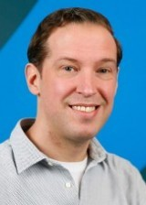

It’s great to meet you
Academic Coordinator Digitalisation, Surveillance & Societies
Monitors the content and alignment of courses;
Proposes and implements concrete adjustments.
PhD Candidate Digitalisation, Surveillance & Societies
Dr. Daniel Trottier
Qian Huang

Slide 4
Introducing Digitalisation, Surveillance & Societies
The programme has 3 key themes:
1. The expansion of surveillance practices
2. The social impact of platform societies
3. Artificial intelligence and algorithms as visions and reality
Notes:
Surv: collection and procesing of information
privacy, but also inequality,
dominant organisation logic
Greater dependence on digital platforms for communication, commerce, politics, education, work
Promise of cutting edge technology: automation, balance harms with conveniences and progressive developments

Slide 5
Key words of the DSS programme
Ethics in tech design
Cancel culture and callout culture
AI and discrimination
Algorithmic (over)dependence
Influencers, admins and other ’power users’
Surveillant imaginaries
Interpersonal surveillance
Privacy paradox
versus
privacy fatigue
Active (digital) citizens
Notes:
Groups: influencers, active citizens
Topics: cancel / callout culture, interpersonal surv more generally
Problems: algo overdep, ai discrimination, privacy paradox (fatigue)
Concepts: surv imaginaries, ethics in design

Slide 6
Study programme
Term 1 | Term 2 | Term 3 | Term 4
Digitalisation and Societal Transformations | Privacy and Ethics in Context | Elective Seminar*, choose from: Digital Research Methods Unboxing the Algorithms Comparative Security Visions and Surveillance Regimes | Master Thesis
Surveillance and Society | Research Workshop*, choose from: Surveillance, Visibility and Reputation Surveillance and the Media Interpersonal Monitoring and Cultural Practice | Active Civilians and Communities
Methods of Media Research I | Methods of Media Research II | Master Thesis
Master Class
Please visit courses.eur.nl for descriptions of all courses
* Please note that the offer of elective seminars and research workshops is subject to change
Notes:
4 terms, about 3 courses per term
Core course on surv, social change, privacy and ethics, as well as user-based applications
RW – about to present a slice of one of mine
Elective - these may be updated
Methods training, incl. digital methods, thesis (5ch, 75-90p, 25-30k words), practical skillsets, mentoring

Slide 7

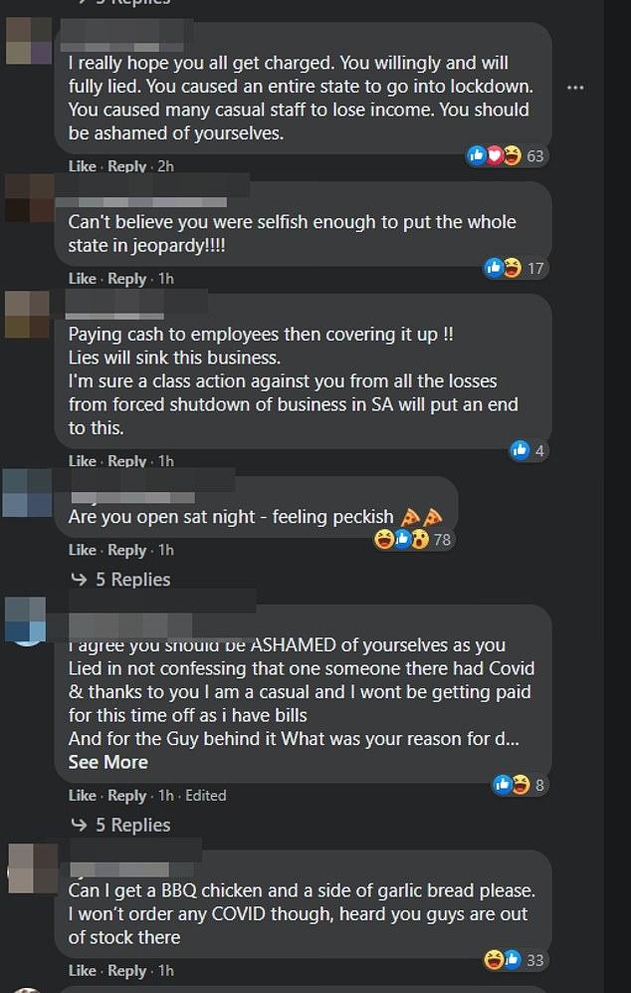

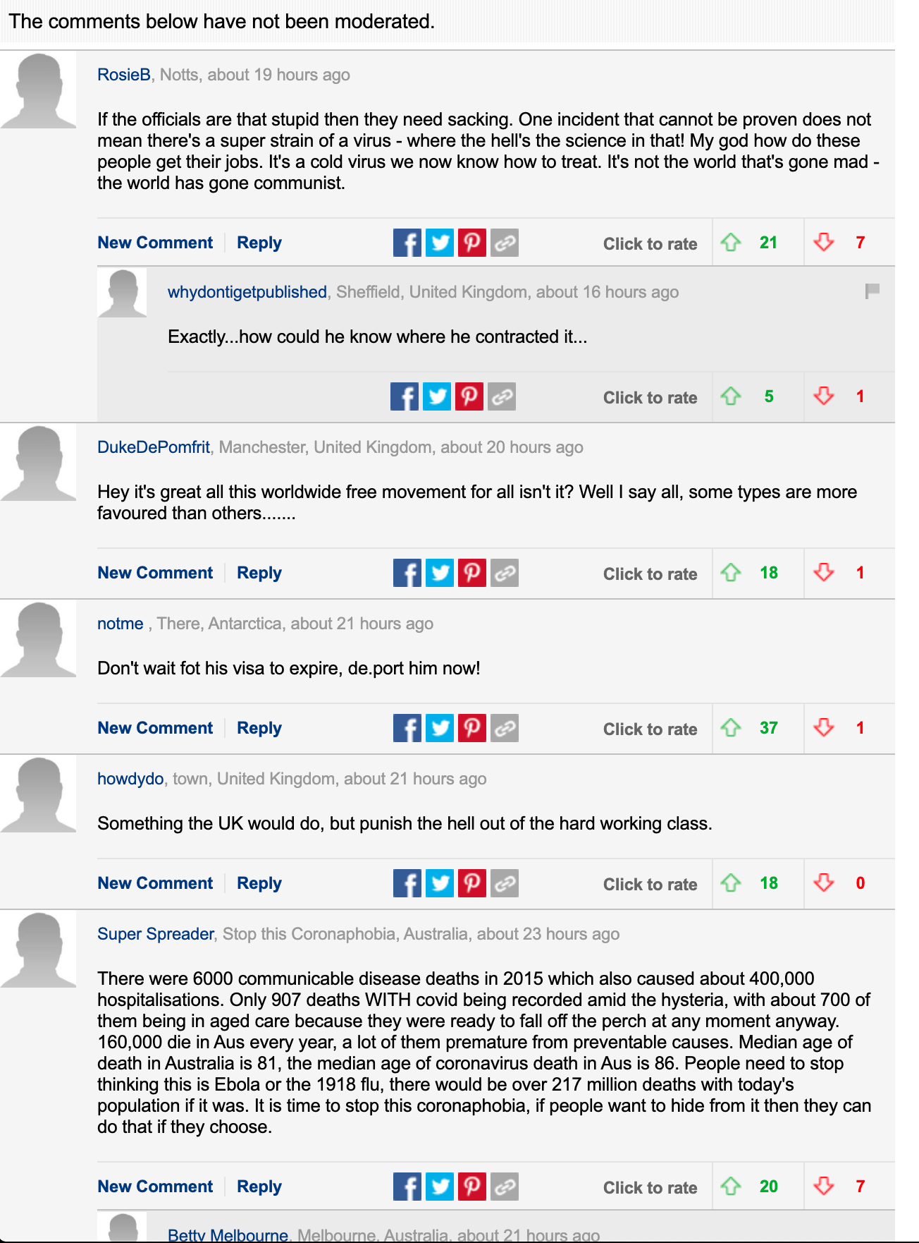
Course deep dive: COVID-19 and social surveillance
Notes:
Individual responsible for lockdown in Adelaide
Target of ire by SA premier (livid), press, and of course online individuals
*** press coverage features online shaming, vitriol
*** also cultivates it in unmoderated comment section
Online mobs, online justice seeking are a global force, seemingly unstoppable
More complicated than we might think.

Slide 8
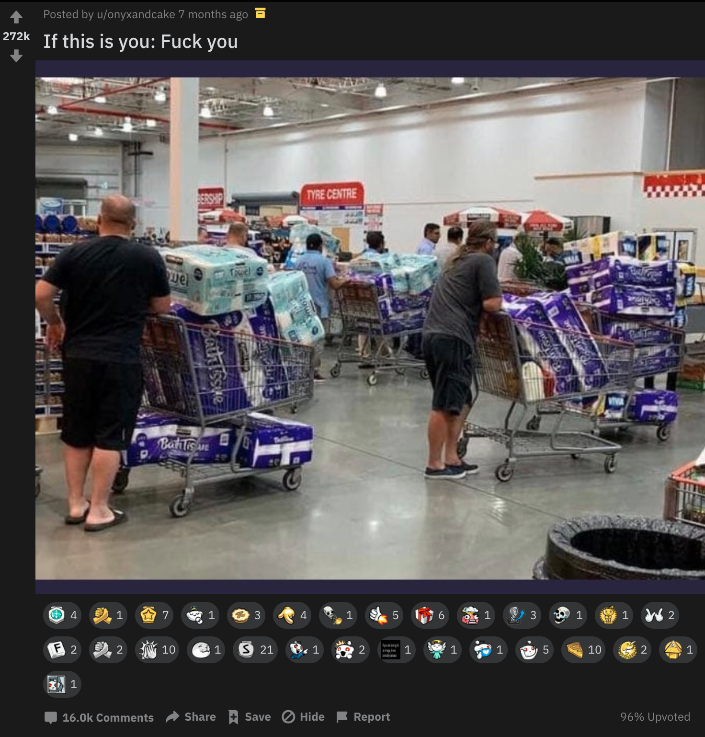
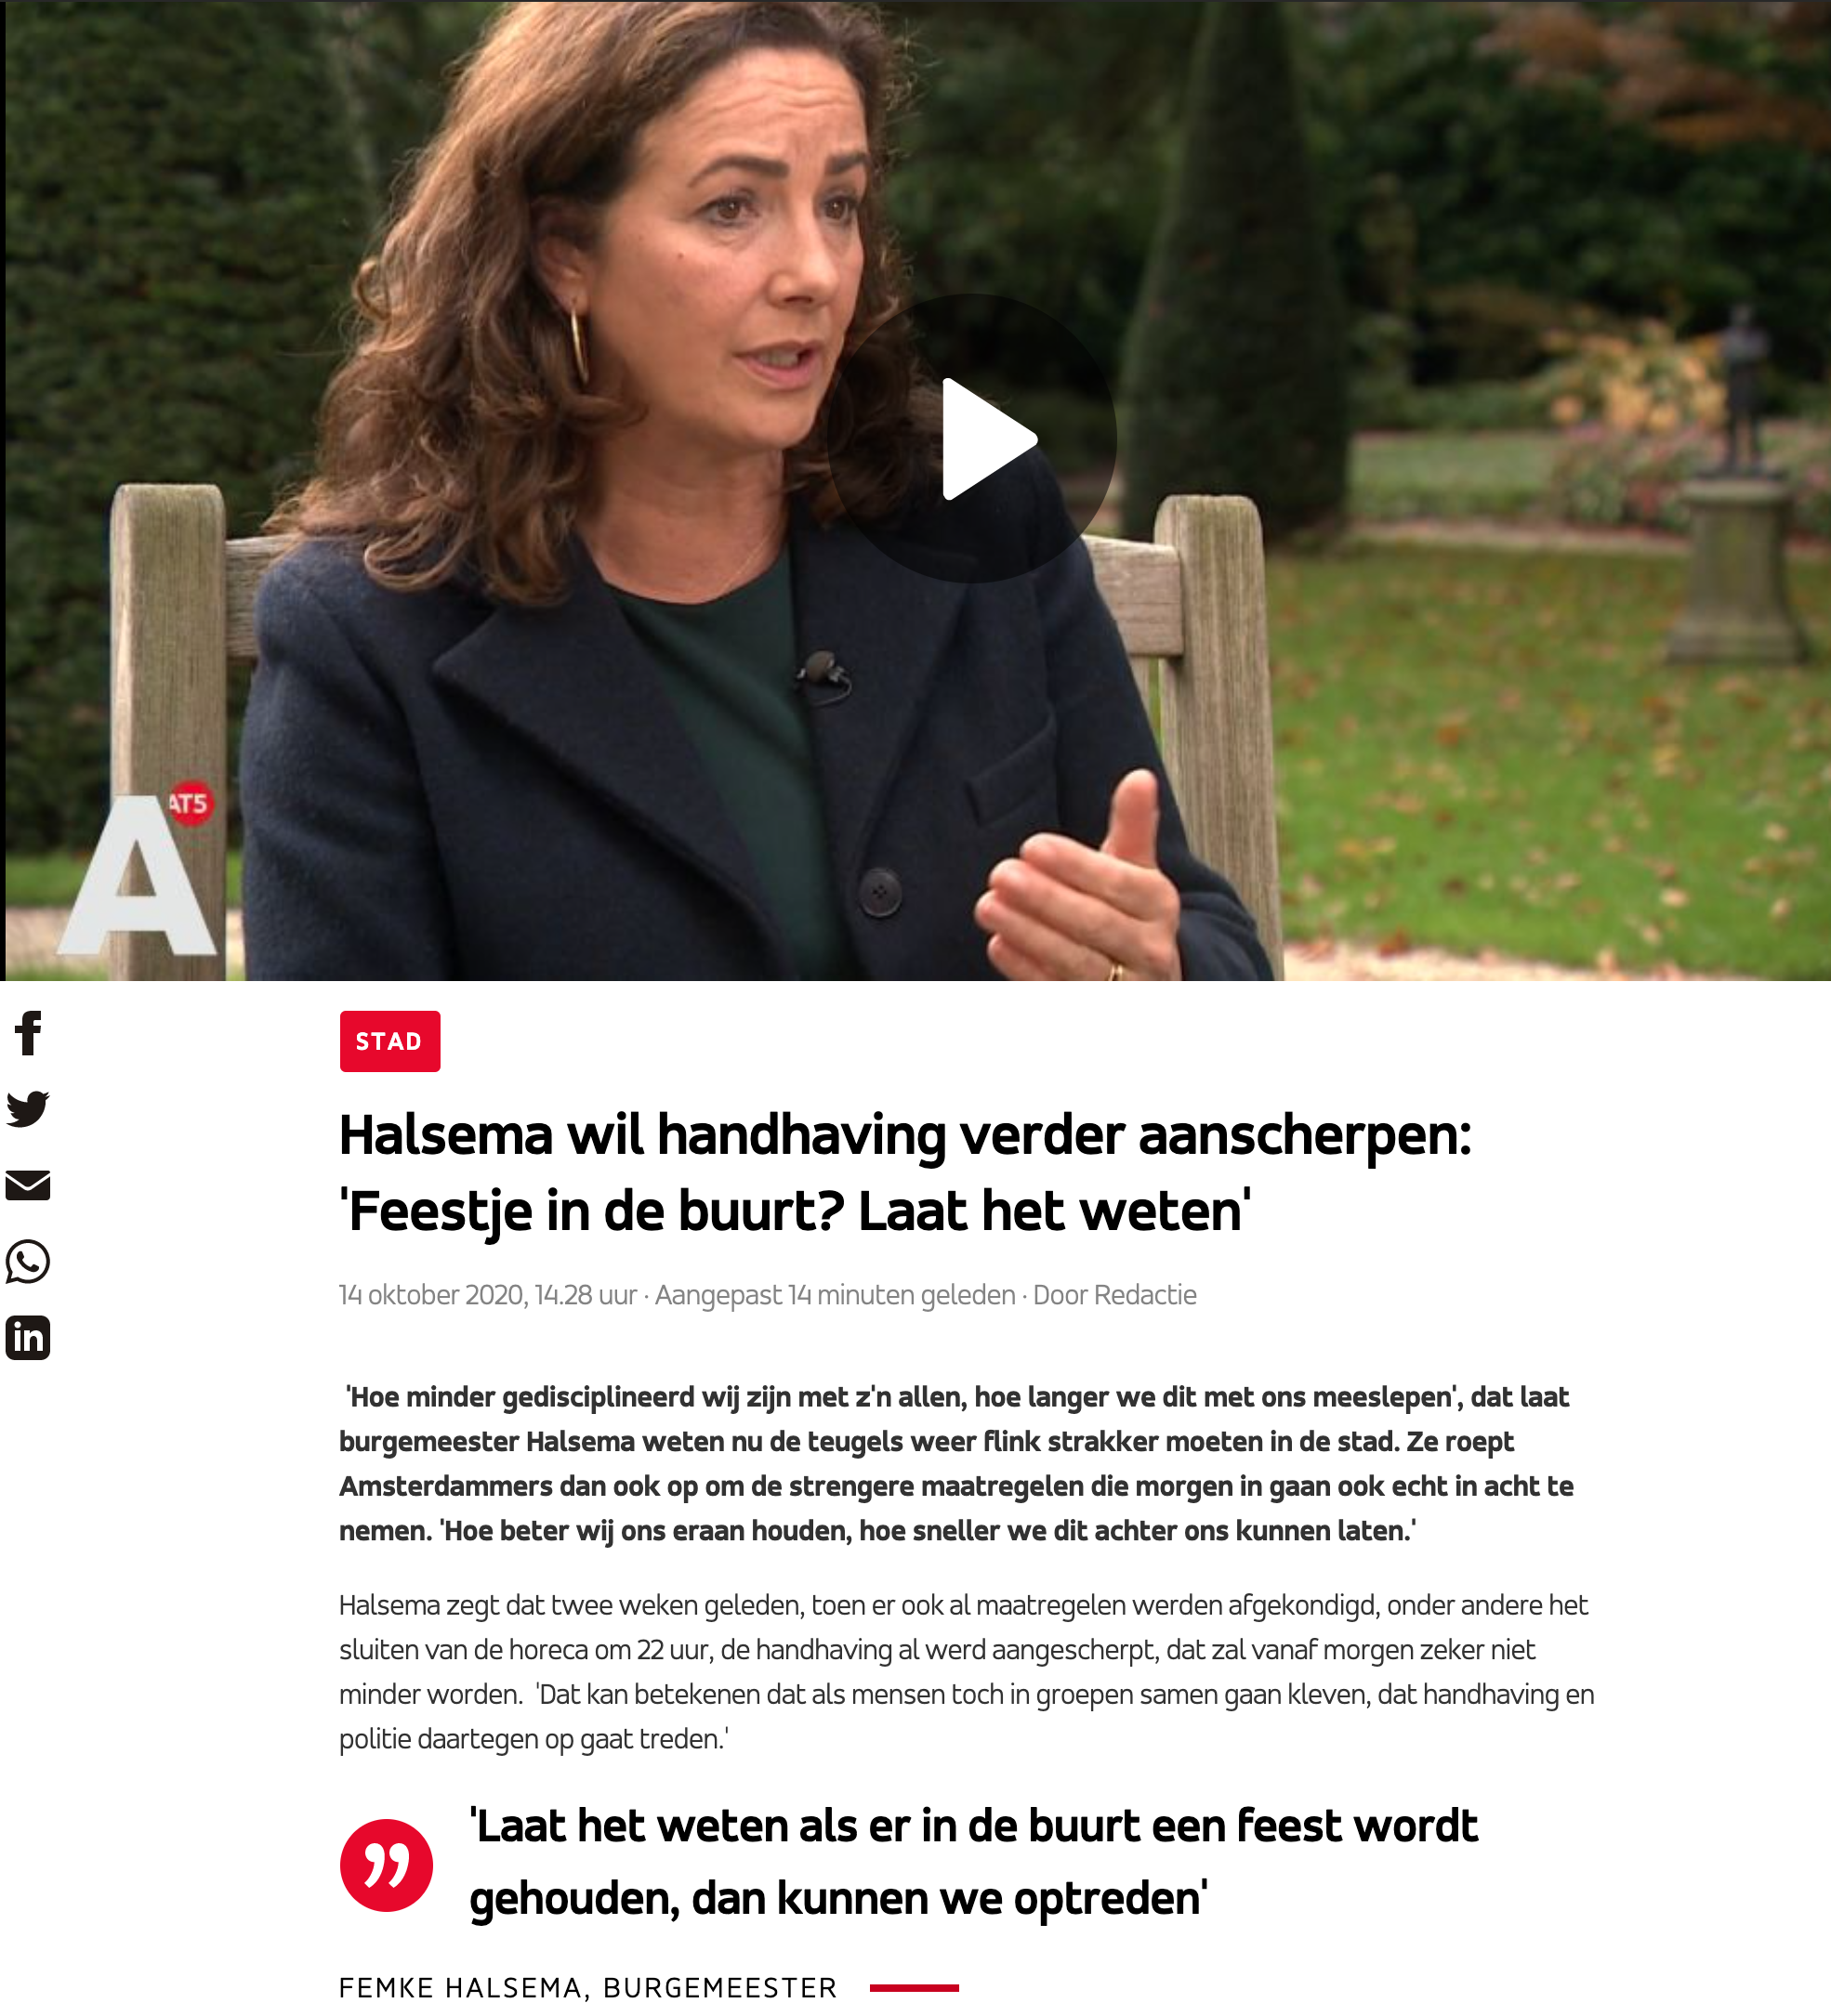
Notes:
Press speaking out, so are politicians
Mayor wants civilian assistance – normally controversial, now understandable
*** And they are denouncing each other indeoendently (dependent on platforms) denouncing new sets of harms, offences (buying toilet paper)
Reddit - global and local
State-endorsed and unregulated are increasingly in tangled relations with each other

Slide 9
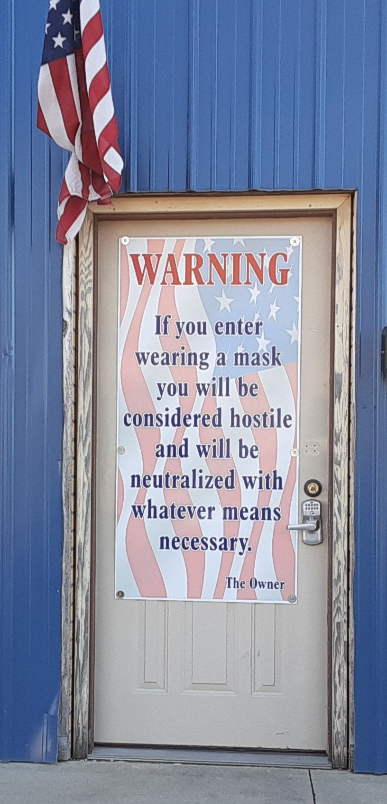
Pandemic Surveillance in Context
Insecurity: vis health, more broadly
Government measures changing
Experts undermining other experts/officials
Pre-existing political and cultural polarisation
News media fuelling points of contention
Mobilising existing networks, communities
Notes:
context: amplifies existing trends:
- insecurity due to health, but also more general societal, precairity: job market, housing market, political impotence, hostile climate
(Ingraham Reeves on media shaming: gives an opportunity for people to exercise some kind of power)
- gov’t measures change on a weekly basis, not always clearly articulated, clearly enforced
ex: public gatherings in NL, wearing masks
- some experts undermine other bodies (RIVM vs CDC)
lots of different kinds of contention
- Existing polarisation, which seems to map on belief, wearing a mask
ex: can’t even give the impression that we agree on this.
- News media addressing these topics: tabloids, cable tv, web platforms - clickbait
- mobilise existing networks (ex: WAPB, local socmed groups, int’l thematic communities)

Slide 10
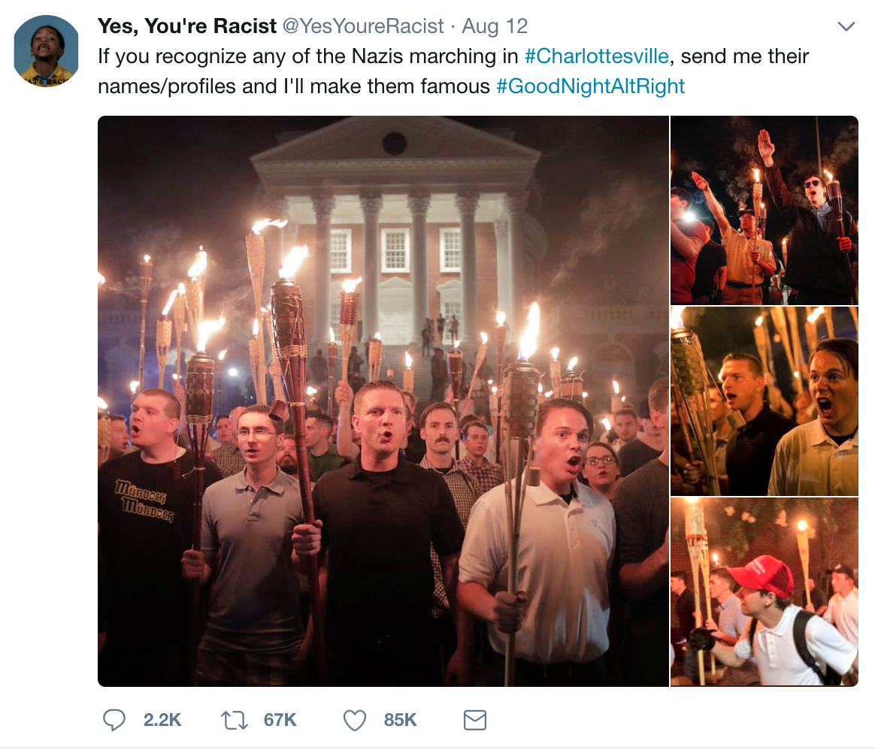

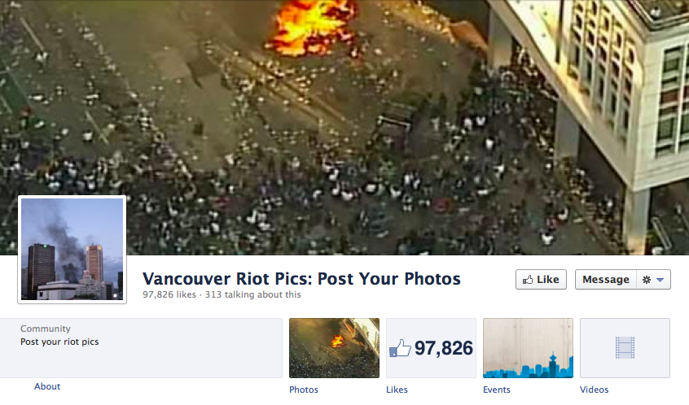
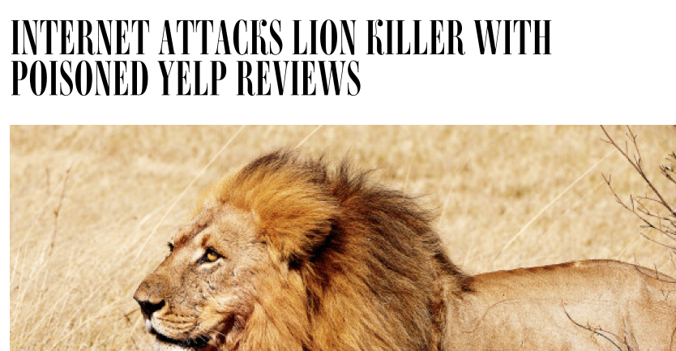
Digital Vigilantism
- A process where civilians are collectively offended by other civilian activity, respond through coordinated retaliation
- Includes, but not limited to ‘naming and shaming’
- Unwanted, intense, enduring visibility
Notes:
These conditions also shape other media practices, like vigilantism
Scrutiny and denunciation of others
…is a process where civilians are collectively offended by others activity, and respond through coordinated retaliation
Includes, but not limited to ‘naming and shaming’
Unwanted, intense, enduring visibility

Slide 11


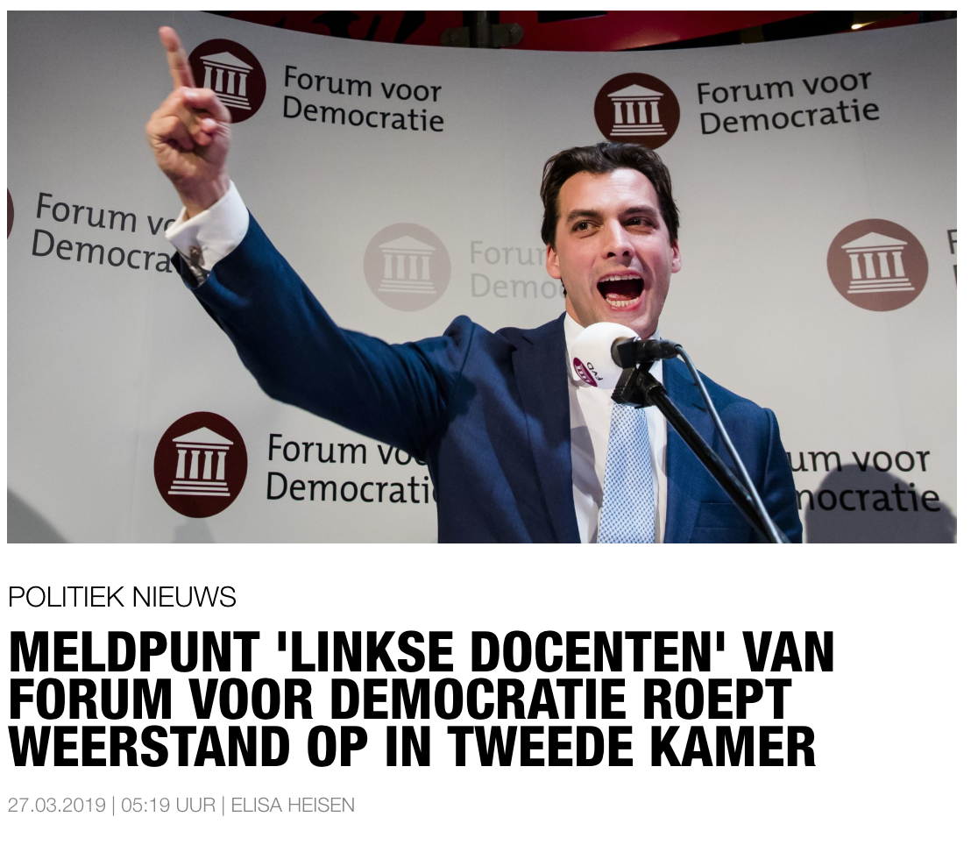
 | Vigilantism (Johnston 1996) | Digital Vigilantism (Trottier 2017)
1) organization | planning and premeditation | greater spontaneity
2) participants | private citizens, voluntary | blurring boundaries w/ police, other institutions
3) social movement | autonomous citizenship self-protection | networked devices & nodal governance
4) violence | use and threat of force | greater reliance on cultural violence (visibility)
5) origin | when social order is under threat | wide range of offences (lower threshold)
6) aims | crime control through assurances | amorphous definition of collective
Notes:
Draw from the term vigilantism – civilians working independently of police
We see that things have changed with the internet
*** 1. Planning: some, but can be minimal. Also organization
→ can more easily be spontaneous (offended in street)
BUT even if act is reflex (still learned), uptake by others constitutes planning
*** 2. Private voluntary agency: should not include police in definition
even if police are off duty, they still enjoy police powers (but can be anon now)
even if privacy companies function within state
may build off police action/content, may be fed into…
Ex: when politicians call upon citizens (ex: against leftist teachers)
3. Autonomous citizenship engaged in self-protection
→ Networked devices and nodal governance
So, cannot say it is purely private (platforms are legal entities)
*** 4. (threatened) use of force
threat is now bound to cultural violence (visibility)
5. Reaction to crime/deviance (PERCEPTION OF THREAT)
Crime control versus social control (ex: racism) (complex relation here)
→ less a matter of policing public space (?)
broader range of offences (lower threshold of taking offence?)
6. Personal and collective security (PERCEPTION OF SEC)
The aim is to “off people the assurance that an established system of order will prevail” (231)
same? but how are boundaries of collective measured?
PERHAPS, making real spaces (or online comments) visible (mediated) as means of establishing security

Slide 12
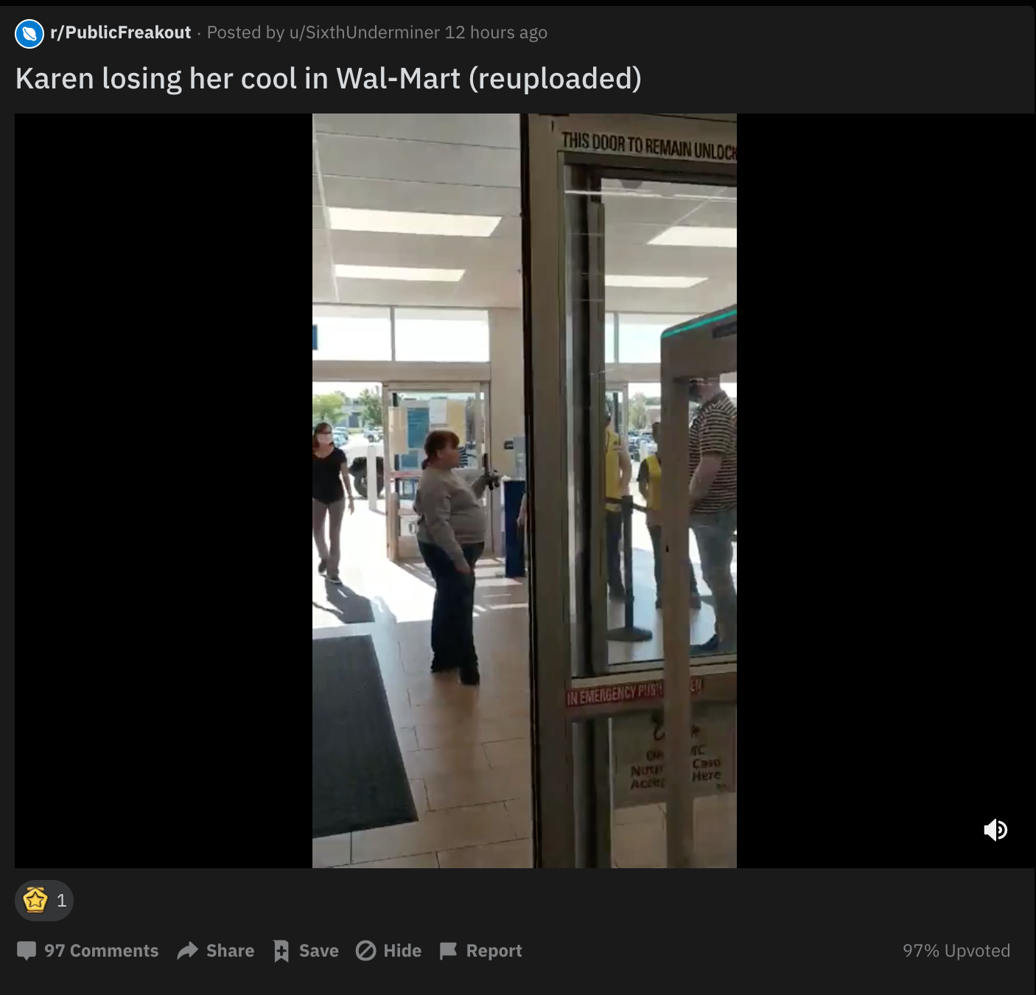
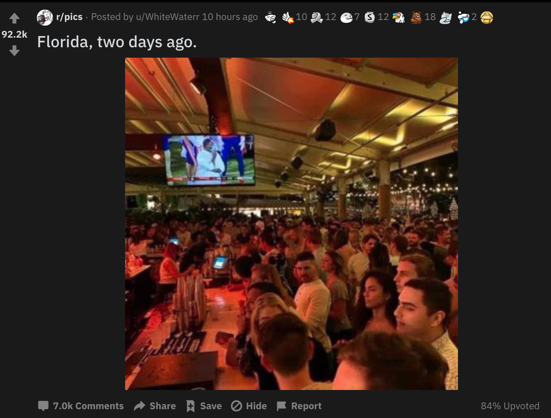
Reddit: Targeted and Categorical Denunciation
Notes:
denunciation: expression of new rules, which are contested
can capture, can editorialise, can comment
unlike vig, and most DV, very little physical interventions
so, job loss
Many distinctions can be made
Used to be: naming / seeking name vs focus on behaviour
But On reddit, both typically blend in to the same practice / outcome?
1) INDIV witch hunt, cancel culture, lack of proportionality
Also of prominent people (politicians, celebrities, influencers)
BUT EVEN INDIV IS FRAMED AS CATEGORY: KAREN
2) FOCUS ON MASS OF CRIME thematic groups, also leads to (implicit) categorisation
But can also lead to people being (mis)ID’d or harmed as a result
SO, NO SINGLE USER CAN CONTROL (IT CAN TARGET; IT CAN GO WIDE; IT CAN BACKFIRE; IT WON’T BE PROPORTIONAL)

Slide 13
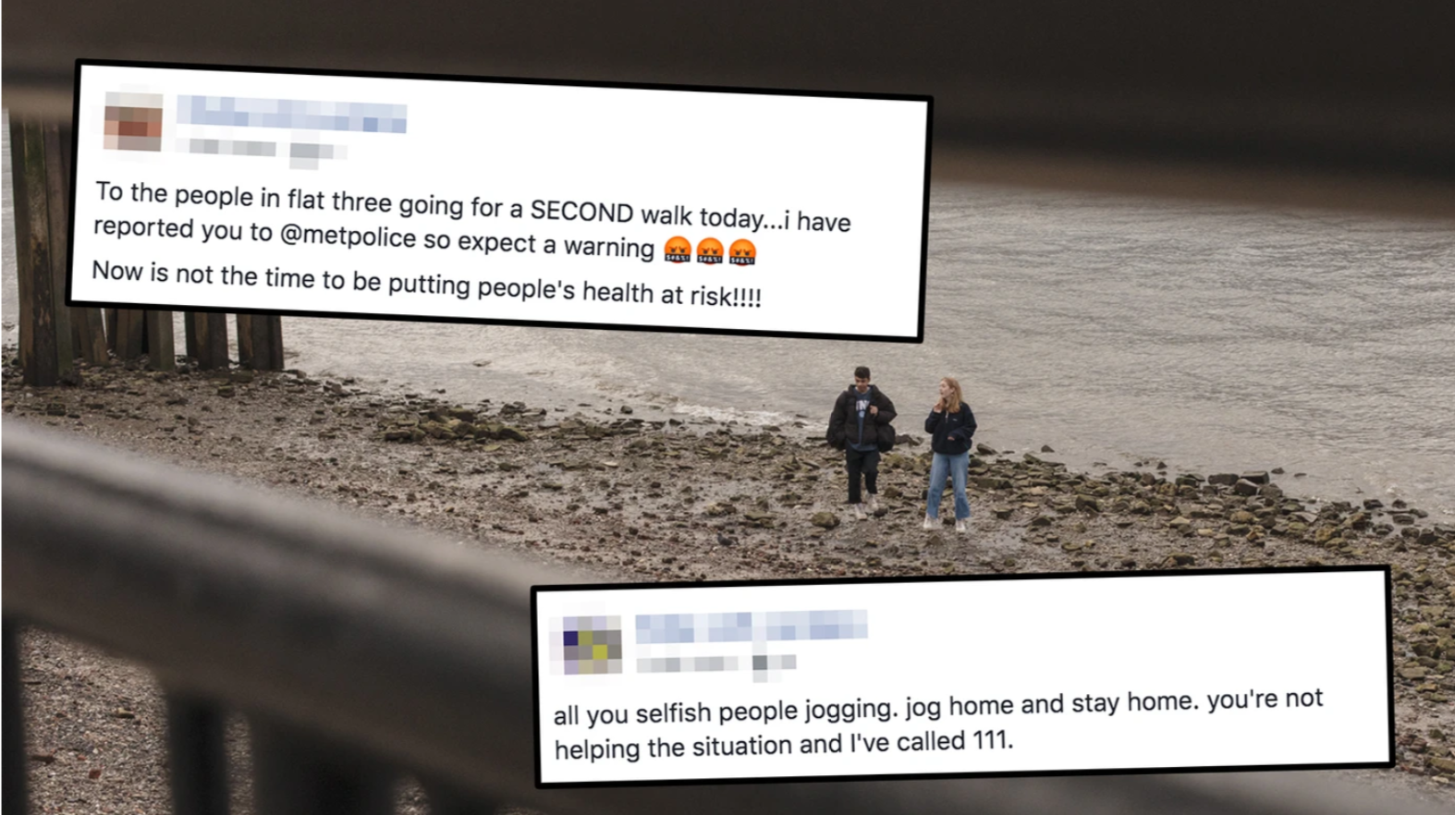
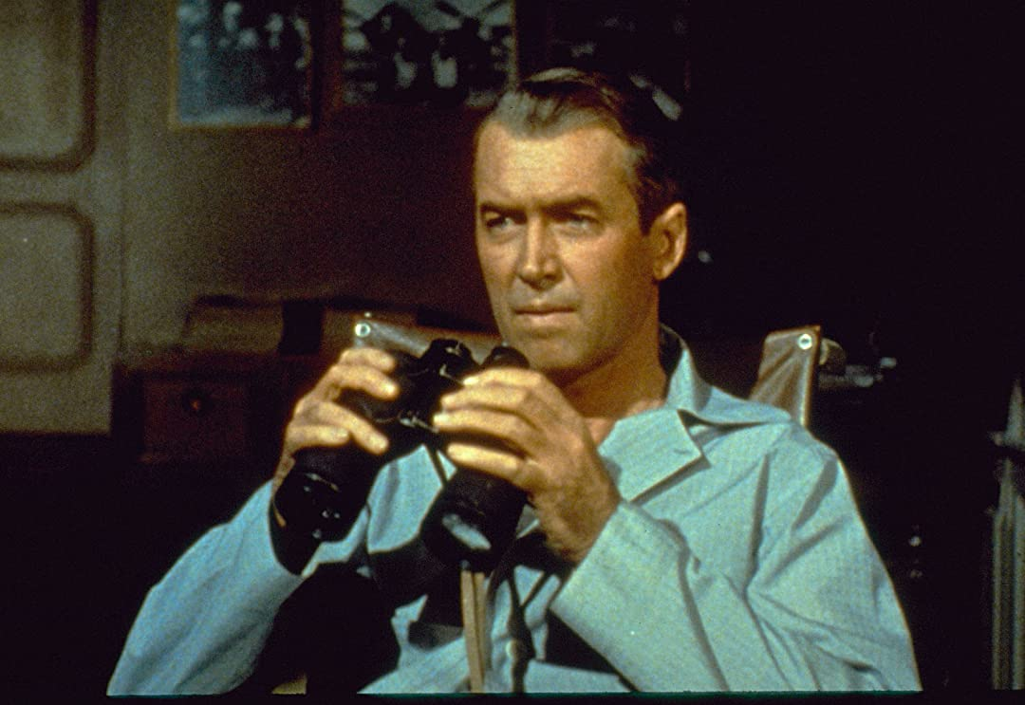
Consequences of Lockdown Measures
- New set of offences / reasons to denounce others
- New set of personal grievances
- Further discovery of new tools among civilians
- Securing urban spaces remotely (assembled, partisan, contested)
- Amplifies existing civil strife
- Emerging forms of entrepreneurial populism?
Notes:
main consequence of lockdown measures: going out, having guests, hoarding, masks, eating in restaurants, public gatherings
- new set of offences / reasons to denounce
new kinds of ways to piss of neighbours in 2020
New set of personal grievances against which to measure these offences
SETTING NEW PRECEDENTS, CAN SPREAD ELSEWHERE
ex: being stuck at home; being vulnerable, having made sacrifices
further justification, feeling less secure, less control over own conditions
- further discovery of new tools, among a more mainstream range of civilians
lockdown, further colonisation of social life by digital platforms
- securing urban spaces remotely (local and digital / on and offline)
CONDUCT IN PUBLIC SPACES IS CONTESTED
- amplifies existing civil strife
(rich/poor ; migrant/local ; left/right)
- Public health → Populism: influencers, Qanon,

Slide 14
The future for DSS alumni
Career fields
Sectors
Journalism
Regulation / privacy impact assessment
Policy work / consultancy
Tech / platform sector
Universities
Public or private think tanks.
Notes:
These are concerns that impact every sector
Good news for you, then
You will be up for careers in the tech sector, as well as journalism, regulation and policy work. Graduates will gain timely expertise well suited to research positions at universities, as well as public and private think tanks. Graduates will be especially well placed to address matters of social impact and social responsibility at businesses that deal with innovative technologies (including household technologies, security, and digital health).

Slide 15


Questions about admissions?
Each applicant has their own background and details. Our Admissions Coordinator will be available through chat today to answer your questions.
Marysia Beekes, BBA
Chat via:
https://www.eur.nl/en/eshcc/contact/chat-our-students
Available between:
10:30 – 12:30
13:30 – 16:30
Admissions Coordinator Media & Communication

Slide 16

Questions about studying Media Studies?
Our Programme Coordinator will be available via chat throughout the day to answer your general questions related to Media Studies.
Vera Dullemond, MSc.
Chat via:
https://www.eur.nl/en/eshcc/contact/chat-our-students
Available between:
10:30 – 12:30
13:30 – 16:30
Programme Coordinator Media Studies

Slide 17



Other sources of information
Visit our website:
eur.nl/en/eshcc/master-media-studies
Media Studies Erasmus
Chat with current students
@mediastudieserasmus
Email us at mediastudies@eshcc.eur.nl
/mastermediastudies

Slide 18
Questions?
Dr. Daniel Trottier
Academic Coordinator Digitalisation, Surveillance & Societies
Qian Huang
PhD candidate Digitalisation, Surveillance & Societies

Slide 19
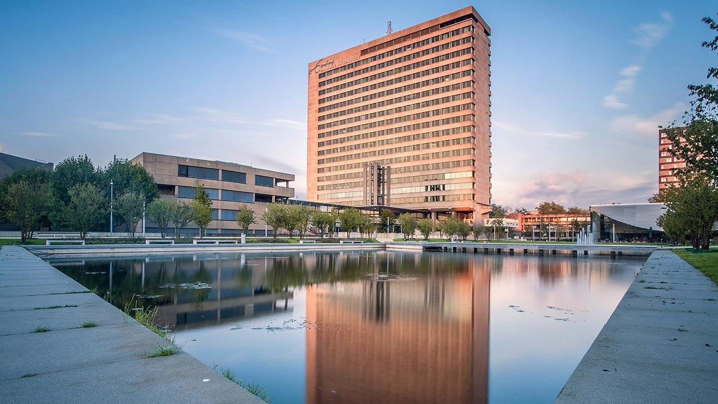
Thank you!

